Slide 1

Team Training
Digital Asset Manager

Slide 2
Agenda
Introduction to Lytho Digital Asset Manager (DAM)
Platform Overview & Navigation
Asset Manger
Brand Center (delete from presentation if not applicable)
Tempo (delete from presentation if not applicable)
Workflow + DAM (delete from presentation if not applicable)
Additional Features
Action Items

Slide 3

Welcome to Lytho DAM!
Lytho's Digital Asset Manager provides a better way to store, share, and safeguard your assets in ways that make sense for your brand, minimizing the friction in the search process so you can find files faster and move on to more magical work.
List of all the reasons that your company chose this platform including:
Problems being solved
Outcomes you’re using Lytho DAM to help you achieve
Expectations for trainees following the training (examples: begin storing/viewing assets in DAM, view share brand guides
Provide the dates of your roll-out schedule – when you will train Stakeholders and go live!

Slide 4
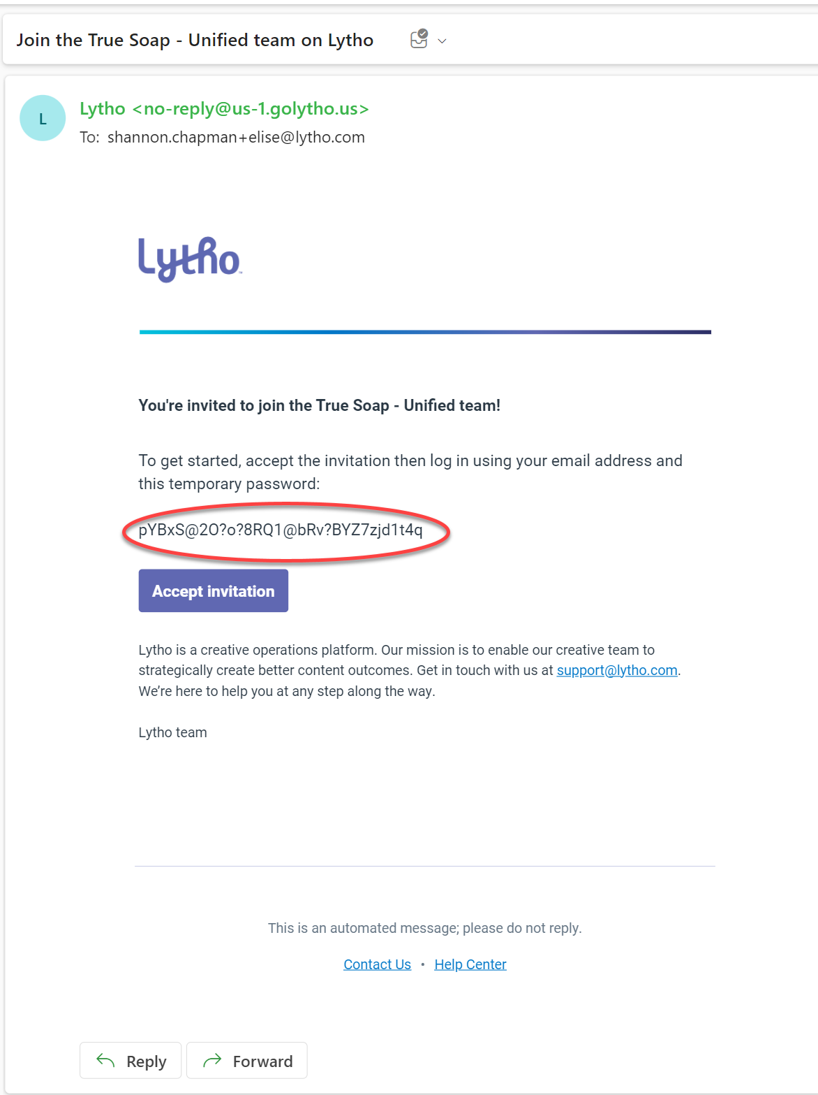
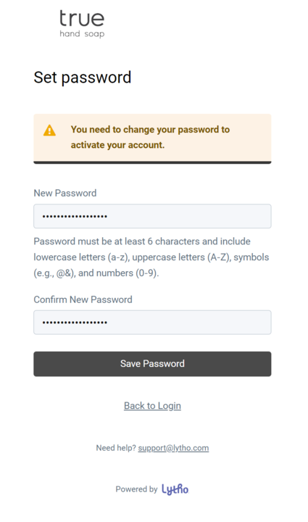
Create Your Account
1
You will receive an email from no-reply@us-1.lytho.us. Accept it!
Invites expire in 24 hours. If your invite expires, contact your name/main admin.
Accept invitation immediately
Create your account by logging in using your email and the temporary password in your invite.
You will be directed to set a new password.
Bookmark our unique DAM URL:
teamname.us-1.lytho.us OR https://login.lytho.com/
2

Slide 5
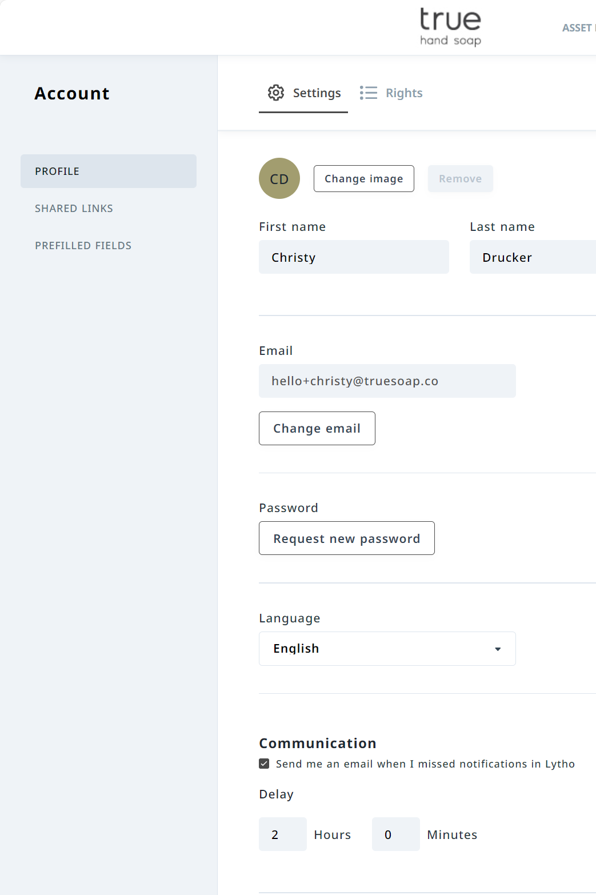
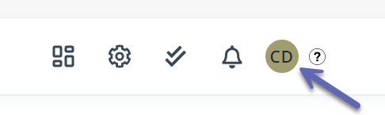
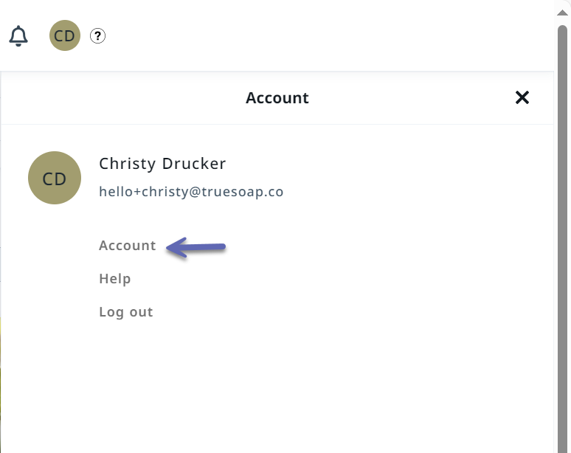
Updating Personal Settings
2
Access your Personal Settings
Update your Profile and Communication preferences
1
Read More: https://support.lytho.com/support/solutions/articles/151000190080-customize-your-profile

Slide 6
Platform Overview & Navigation

Slide 7
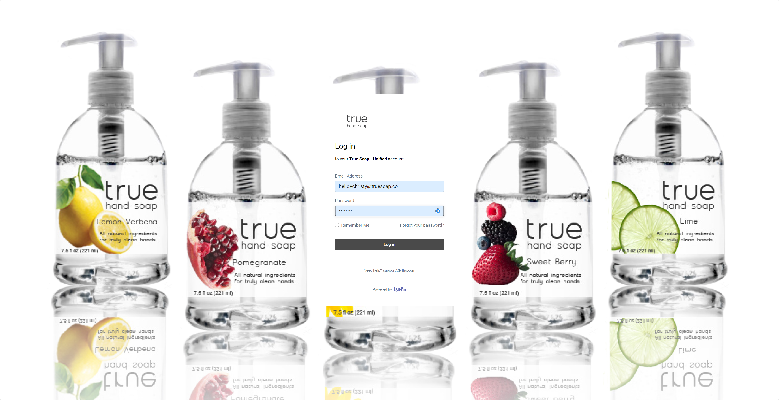
Login Page:
Navigate to your organization’s unique url (add your url here)
Enter your login information
Click Log in
Read More: Quick Start Guide: Find What You're Looking for Fast | Lytho Guide

Slide 8
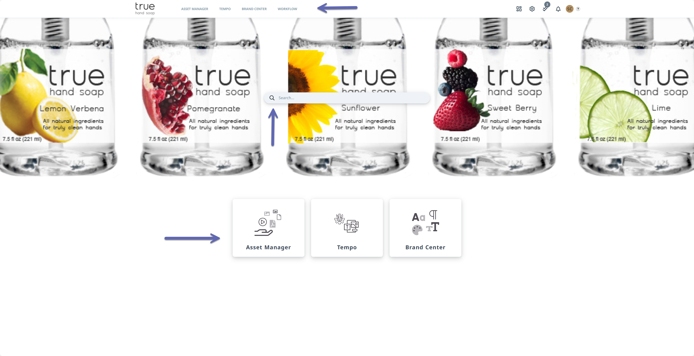
Homepage:
You can navigate to the different modules of your DAM using the Top navigation or the Shortcut images
The Search bar on your homepage is a global search and will search everything in your DAM.
*Your navigation and shortcut images will depend on the modules purchased for your DAM.

Slide 9
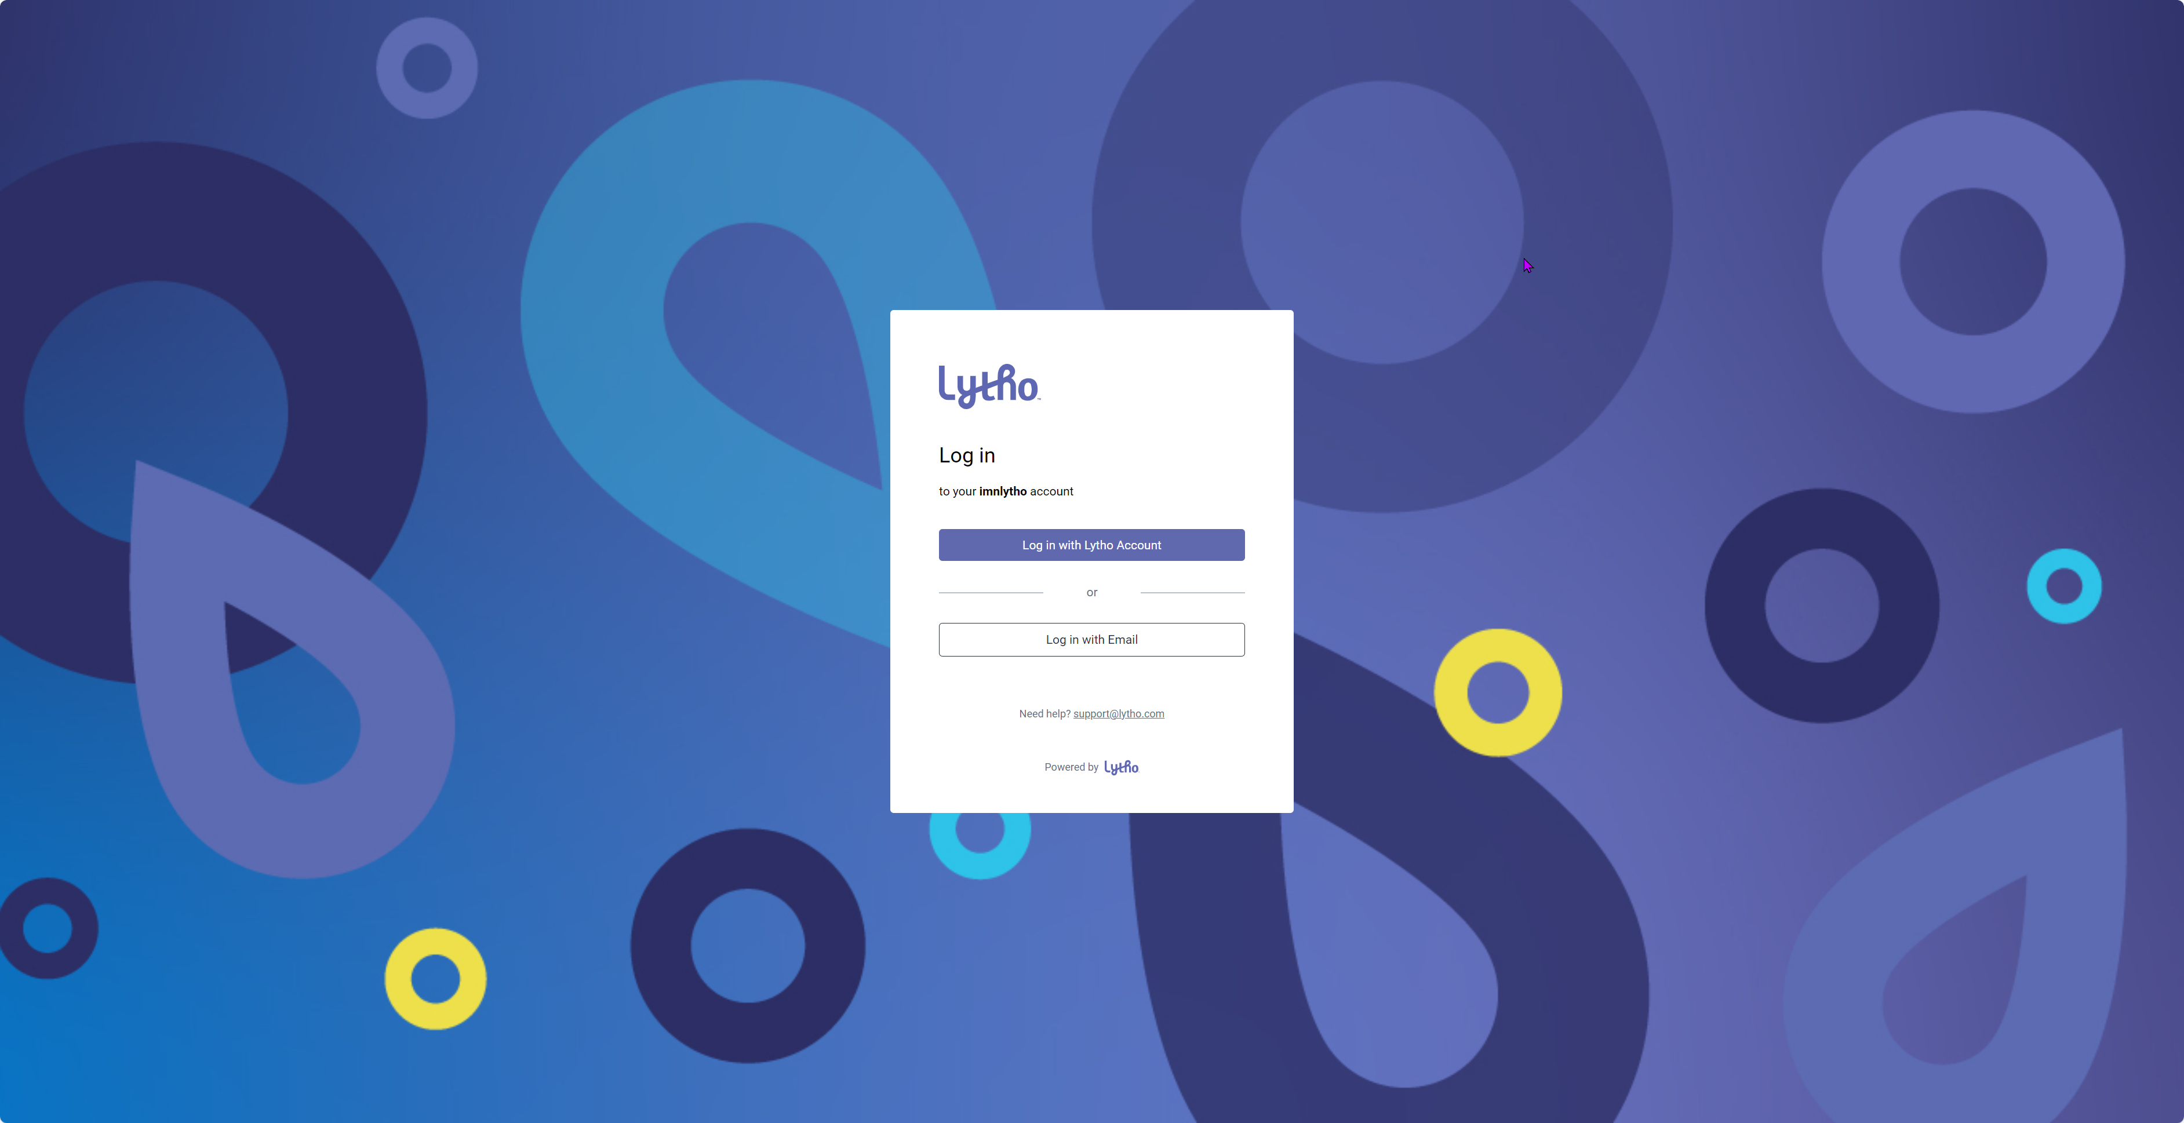
Single Sign-On Login:
Update slide with screenshot of your SSO login page
Single Sign-on allows you to validate usernames and passwords using your company directory instead of logging in through Lytho.
Delete slide if SSO is not part of your contract

Slide 10
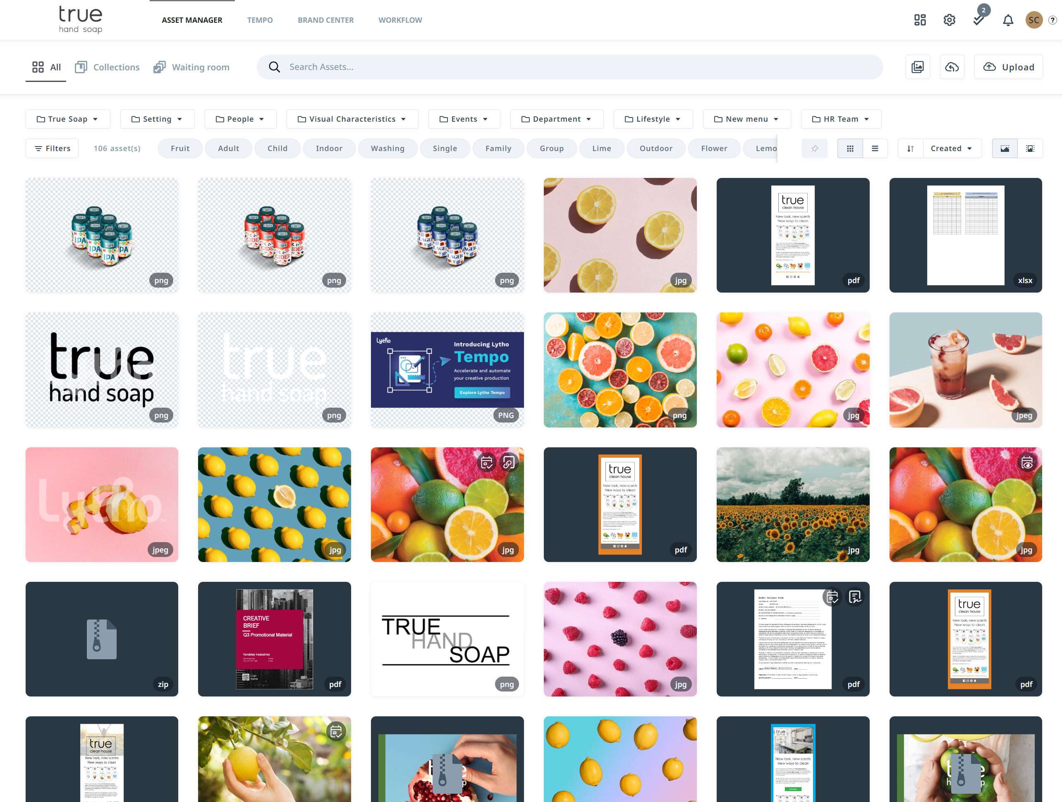
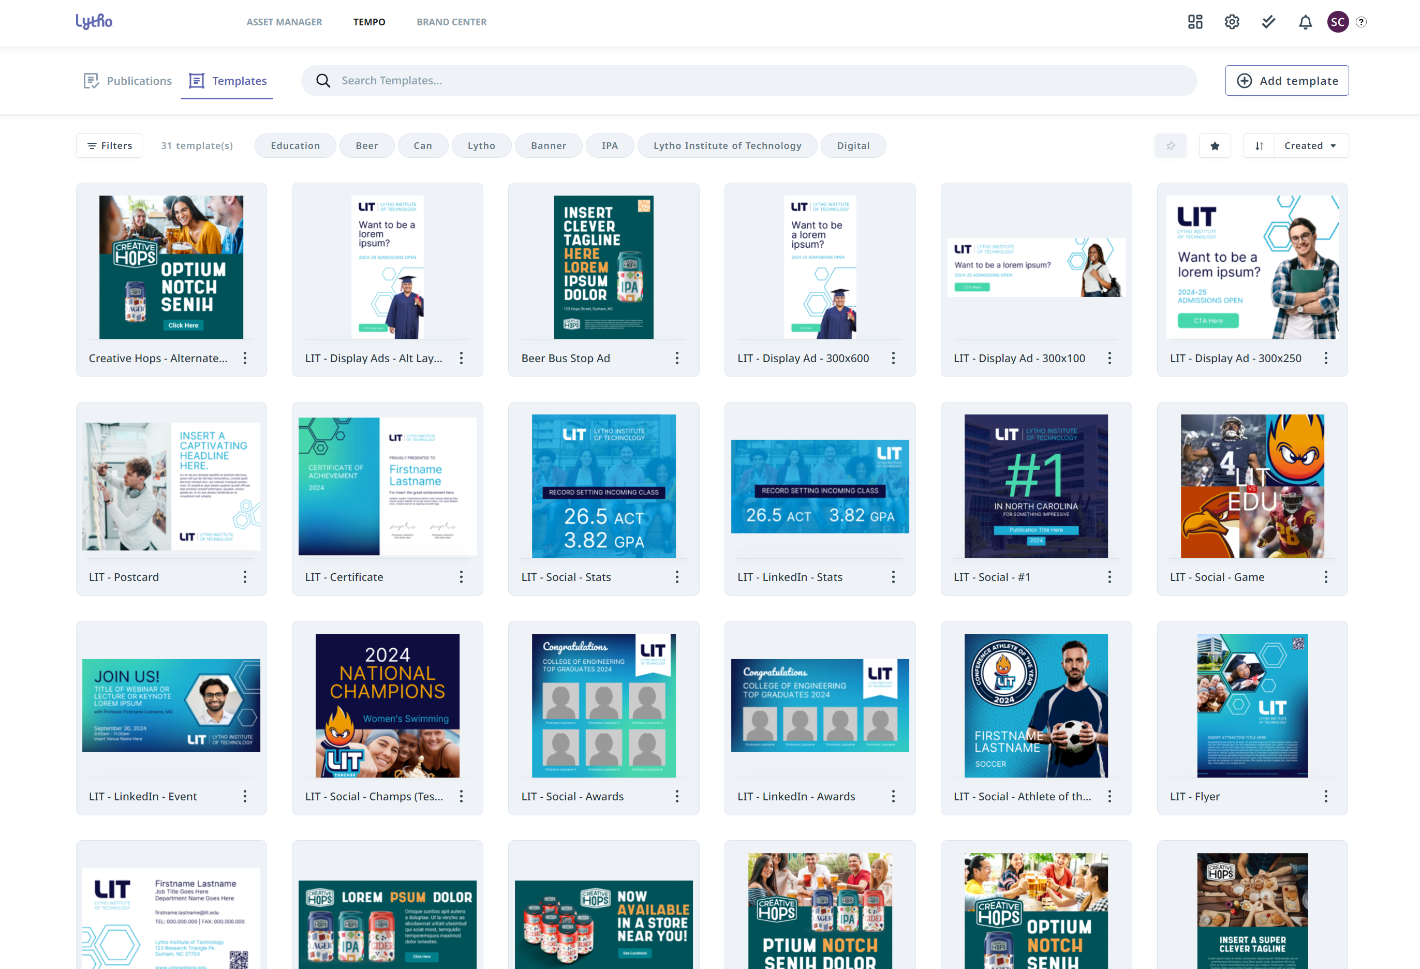
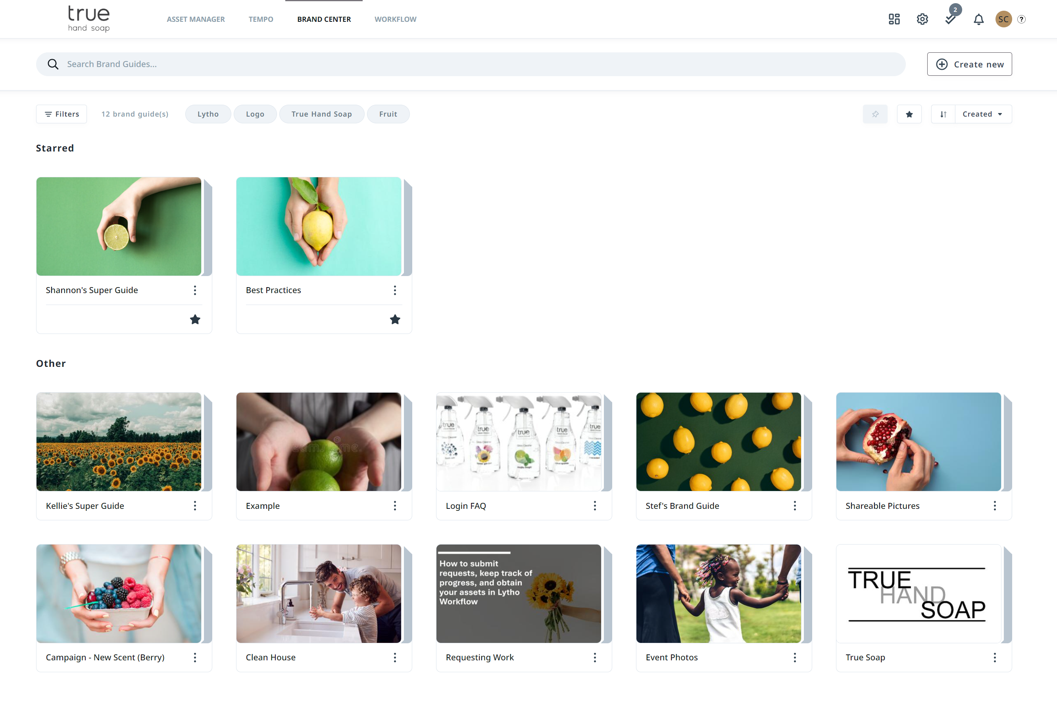
Asset Manager
Tempo
Brand Guides
Search, download, and share assets with just a few clicks all within Lytho's Asset Manager.
Your design team can deliver quality content quickly and in high volume without draining creative resources. Empower your colleagues, stakeholders, and clients to create their own content with Tempo’s easy-to-use and always-on-brand Smart Templates.
Brand guides can be used to store a variety of information but are most used to outline a company’s brand identity.
Update slide with the modules you have in your DAM

Slide 11

Roles vs. Permissions in DAM
Roles*
Determine what a user can DO in the DAM
*All based on Roles created in the DAM.
Example Roles/Titles of Stakeholders:
List titles of stakeholders in your org
Permissions*
Determines what a user can SEE in the DAM
*All based on permissions set within the DAM.
Example Roles/Titles of Team Members:
List titles and roles of team members

Slide 12
ASSET MANAGER

Slide 13
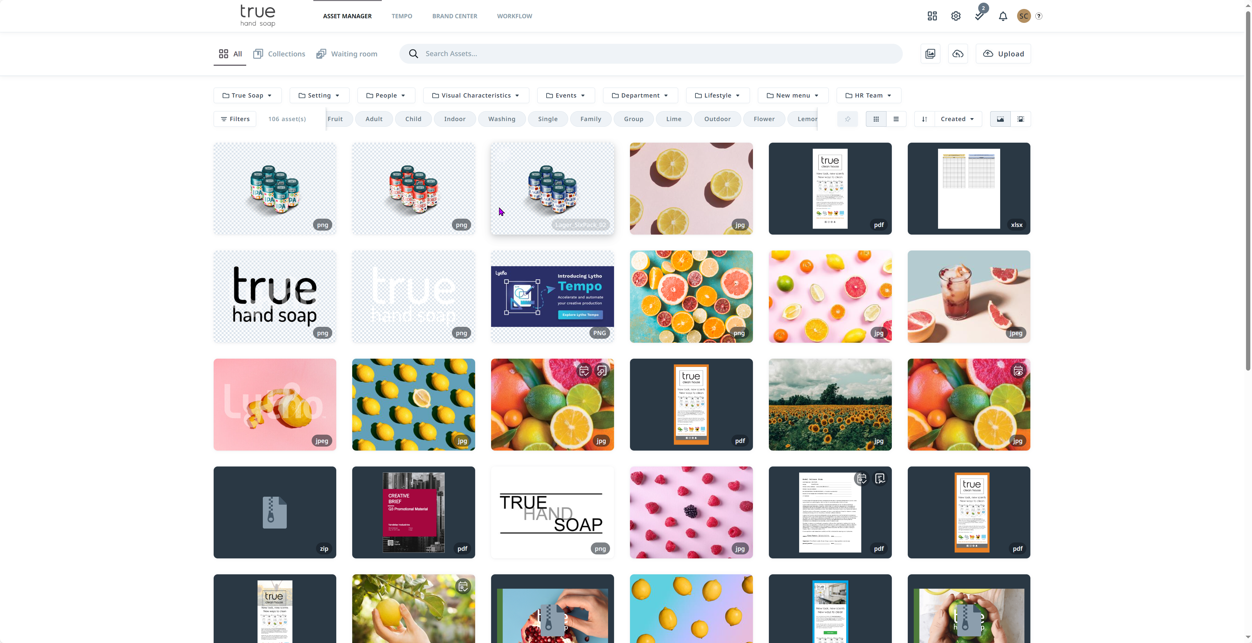
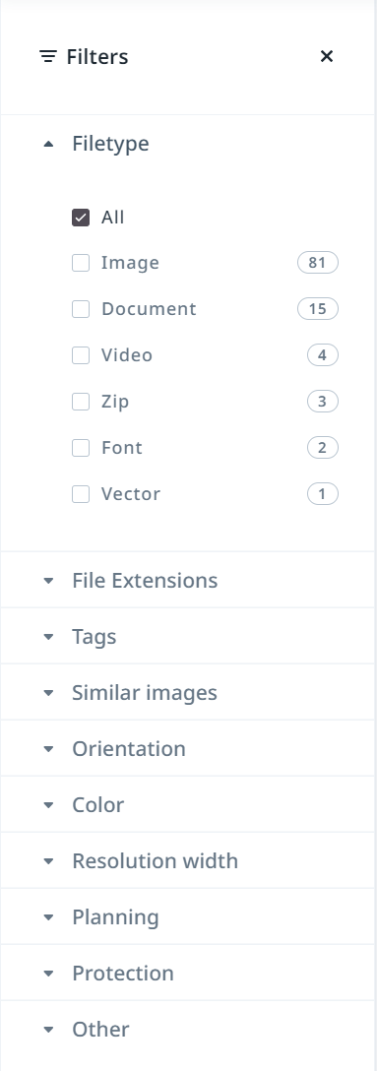
Searching for Assets
Search bar allows you to search for keywords or phrases in the Asset Manager
The Filter option allows you to filter assets
Use the scroll bar to scroll through assets.
There are several filters to choose from
Read More: Navigating The Asset Manager | Lytho Guide

Slide 14
Tags
Take screen shots of your tags in your Account Settings, place them in a bulleted list for your trainees or share your Tag Taxonomy worksheet. Take some time to talk about the importance of your Tag Taxonomy and how your users will use the keywords/phrases to search for assets.
Give examples of how to search for items in your Asset Manager

Slide 15
Custom Fields
(Optional)
Take screen shots of your custom fields or place them in a bulleted list for your trainees. Take some time to talk about the importance of these fields to your organization and how custom fields can be used to search for items in your Asset Manager.

Slide 16
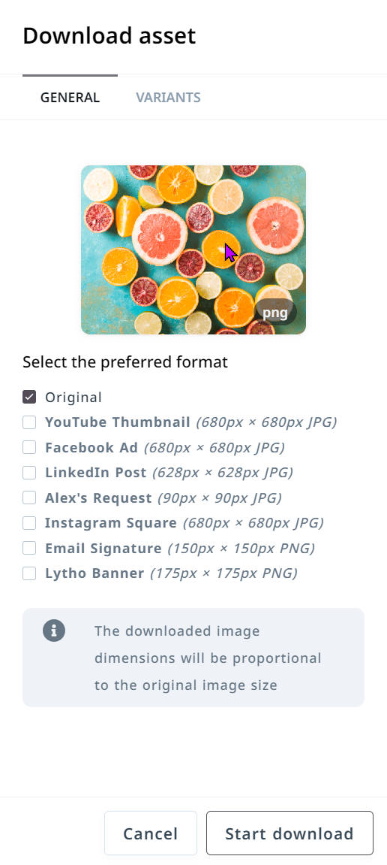
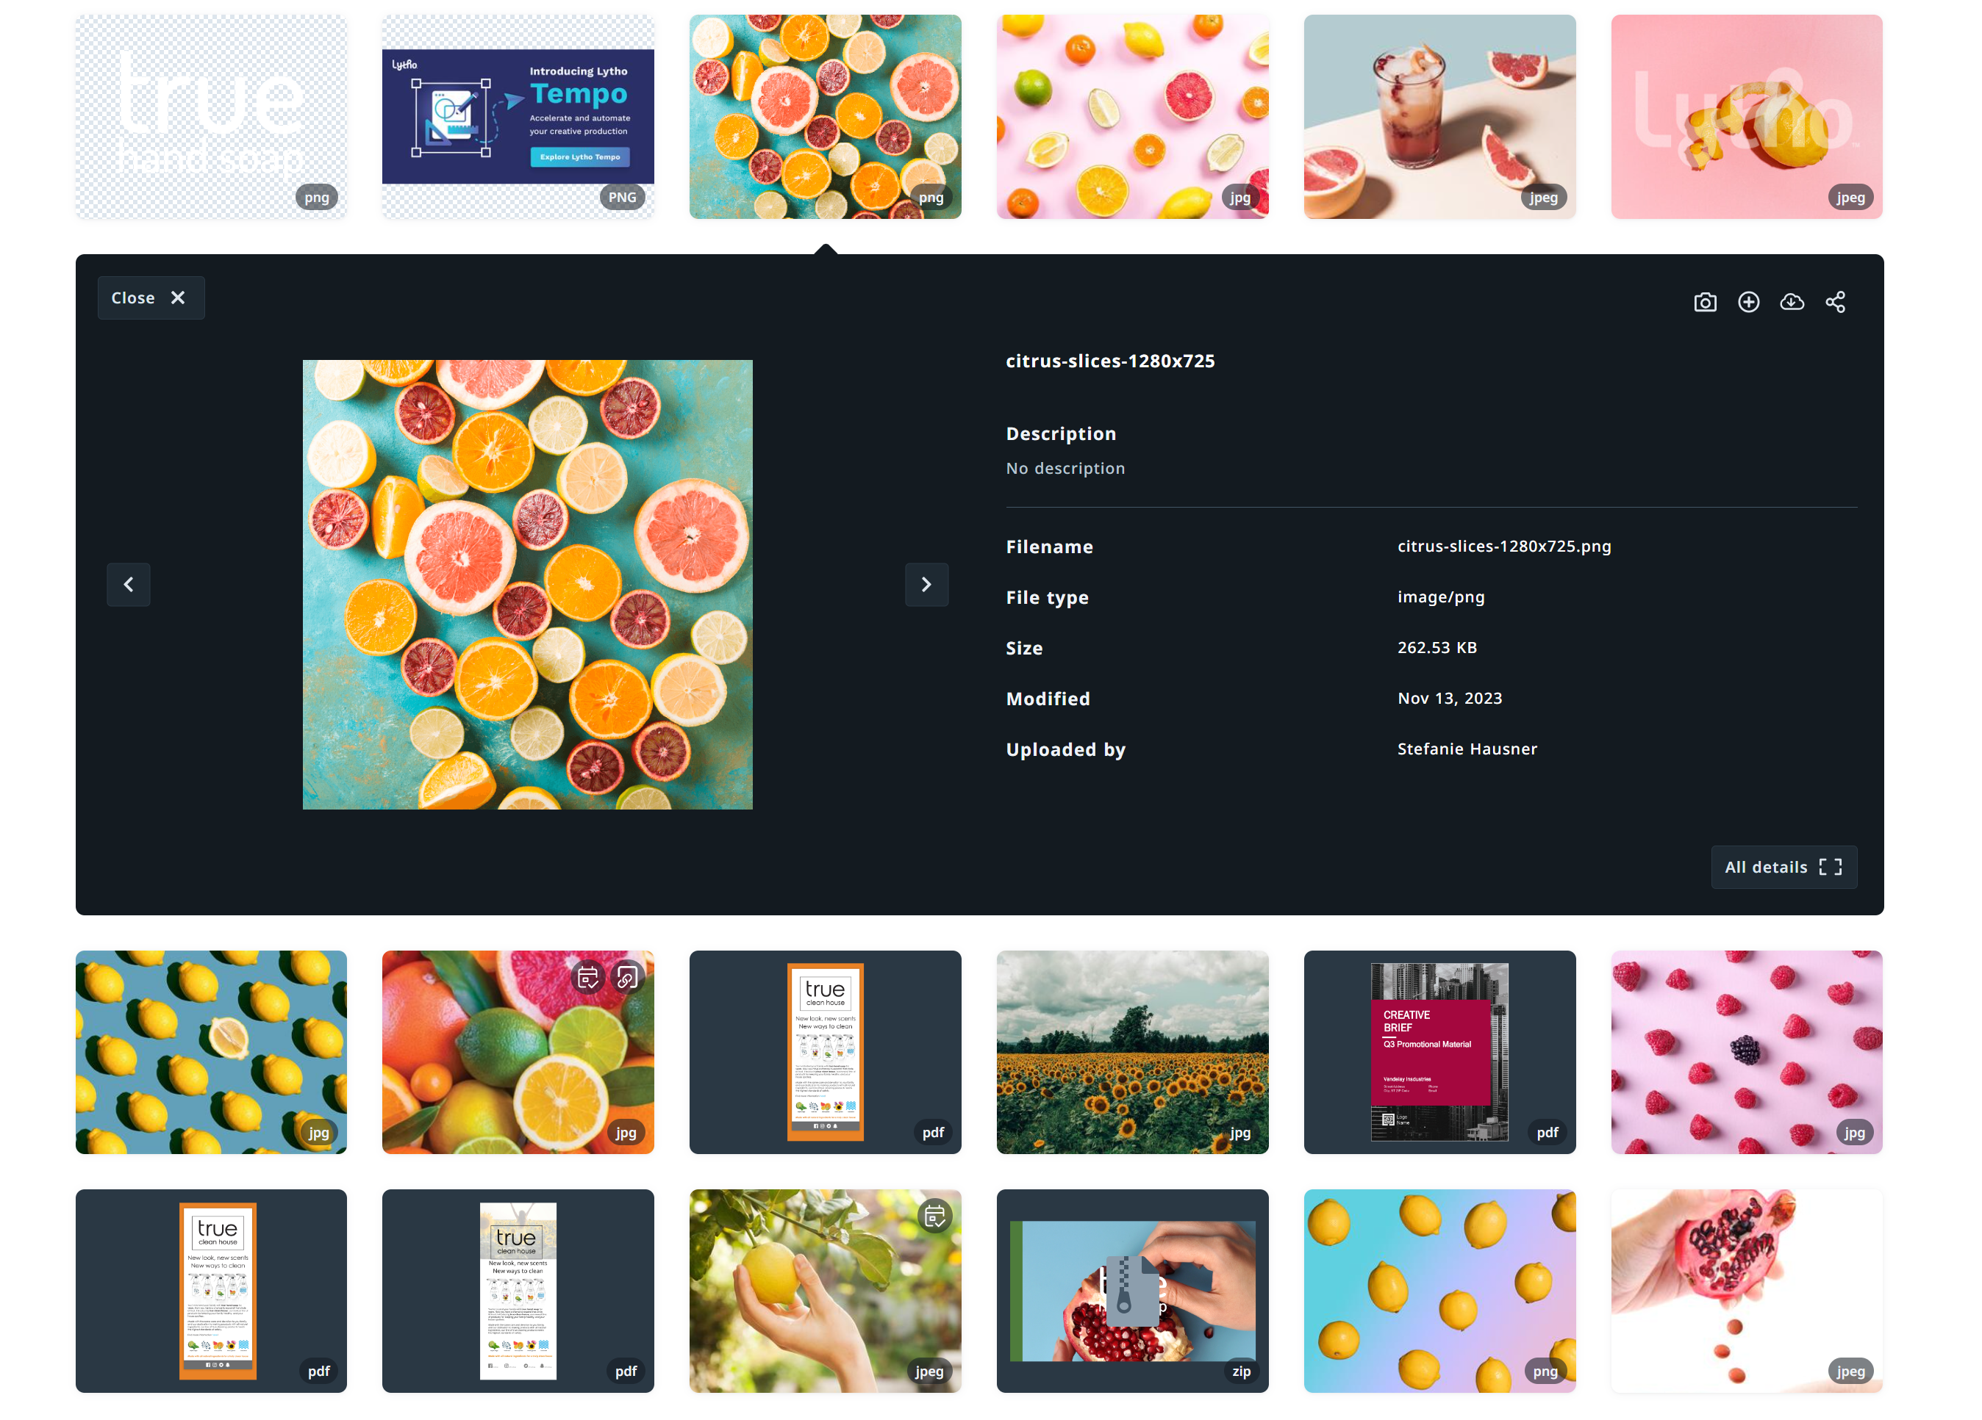

Downloading Assets
Based on your accounts download settings you may be able to choose how you prefer to download the asset.
Click on the asset you would like to download
Select the download icon

Slide 17
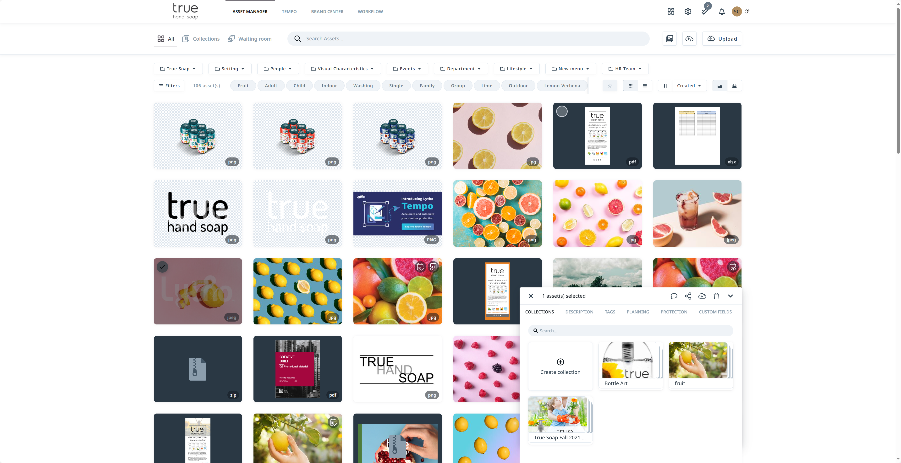
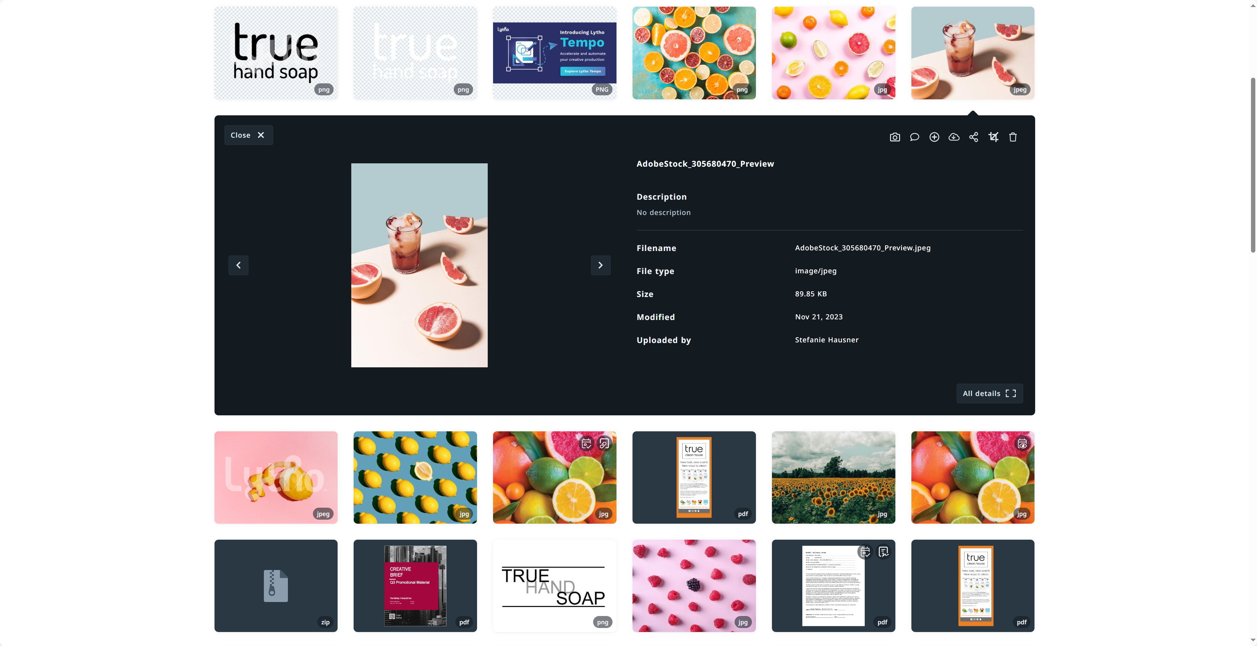
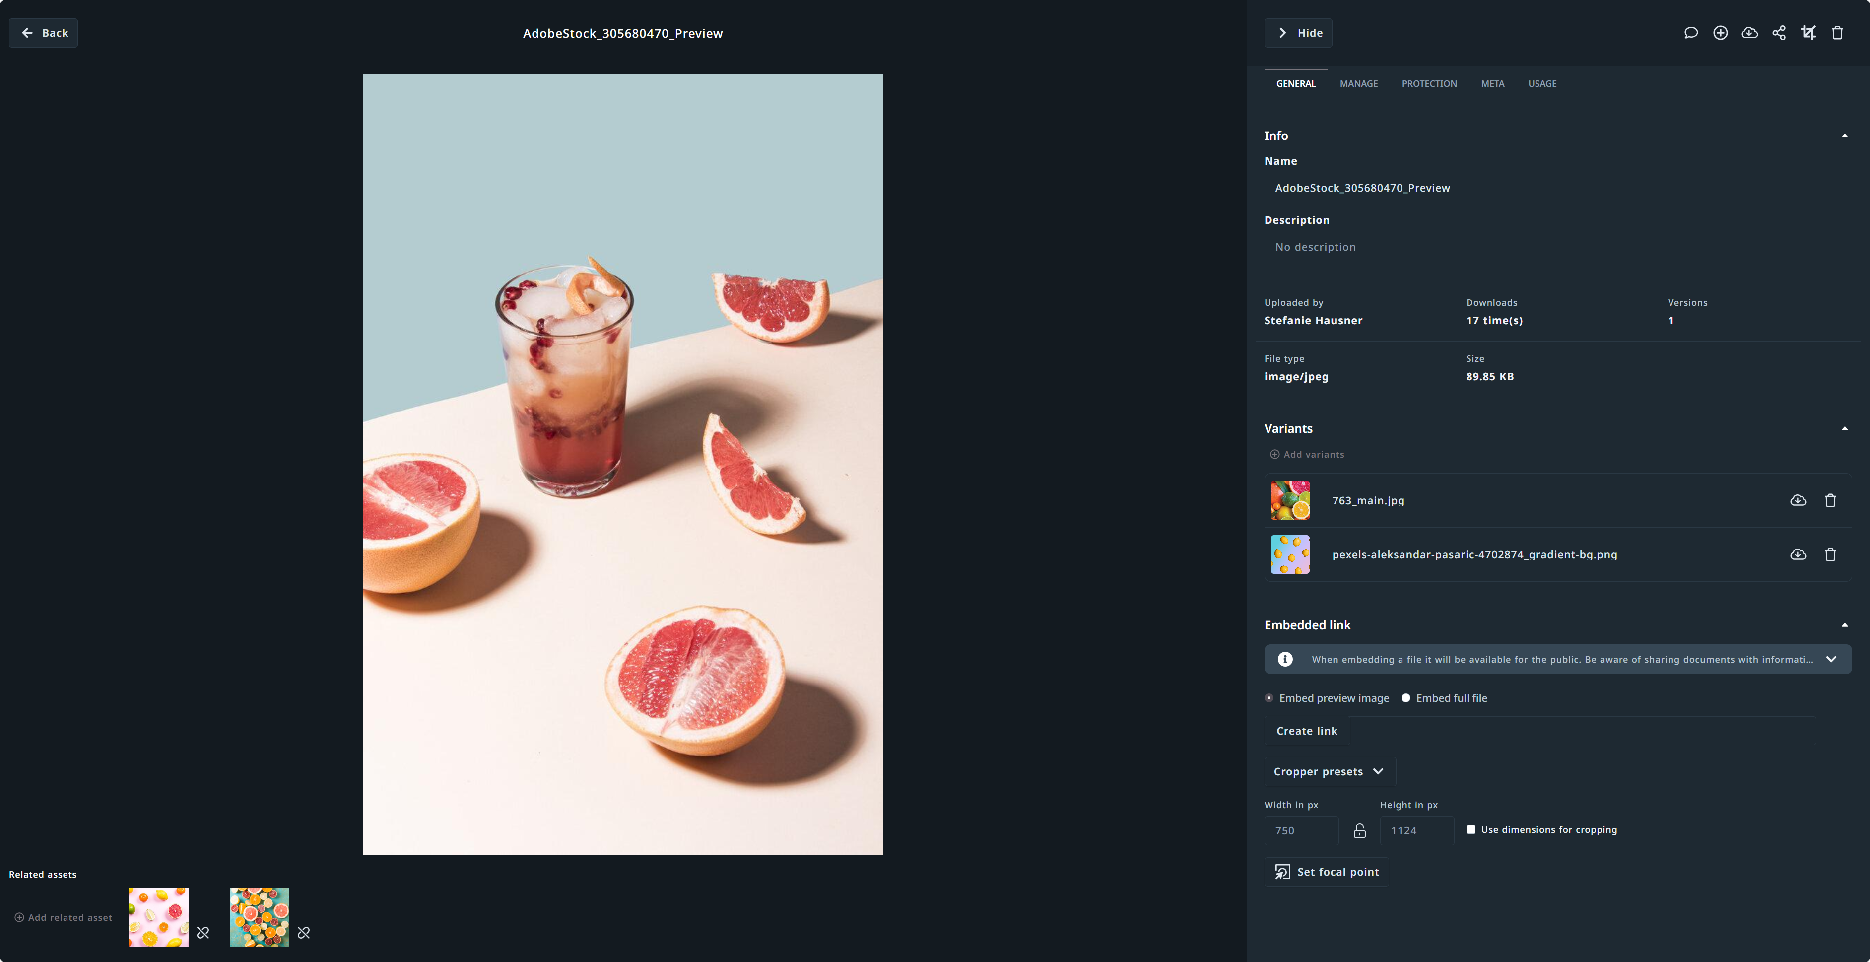
Anatomy of an Asset
Clicking an asset will open the Asset Preview Window.
The All Details in the bottom right-hand corner opens all information relating to the asset.
2
The details panel of an asset will allow you to dig deeper into an asset.
The information under All Details is information related to the asset and is searchable.
You can use this view to:
Download variants
View previous versions
See asset's metadata
Much more
1
3
2
When an asset is selected the Activity Bar will appear in the bottom right-hand corner. Based on your role allowances you may be able to do the following:
Send a message
Share asset
Download
Delete
Create or Add to a collection
Update asset description
Apply Tags
And more
1
3
Read More: Anatomy of an Asset | Lytho Guide

Slide 18
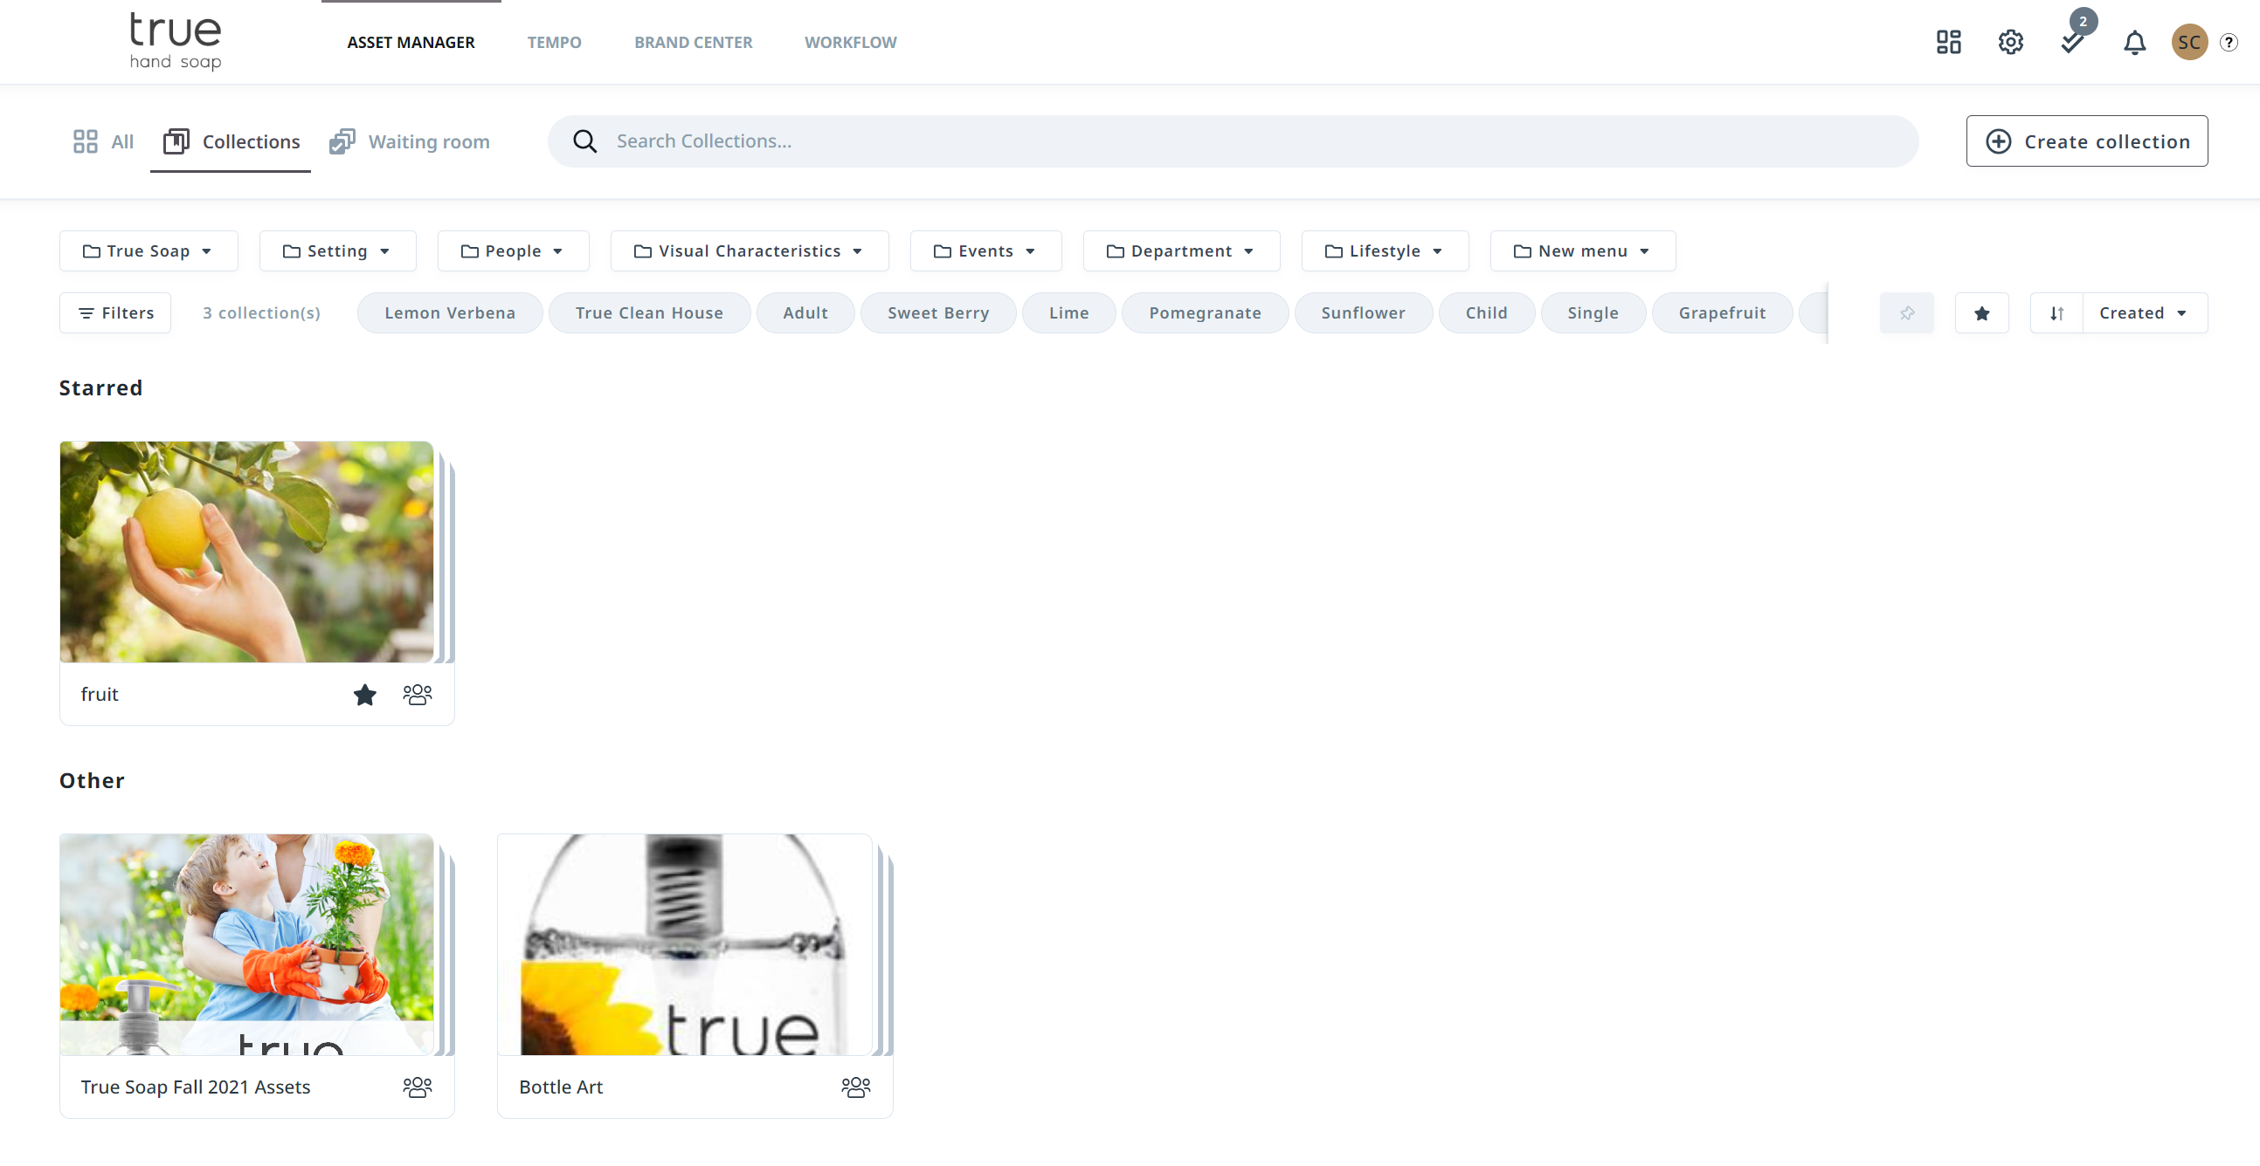
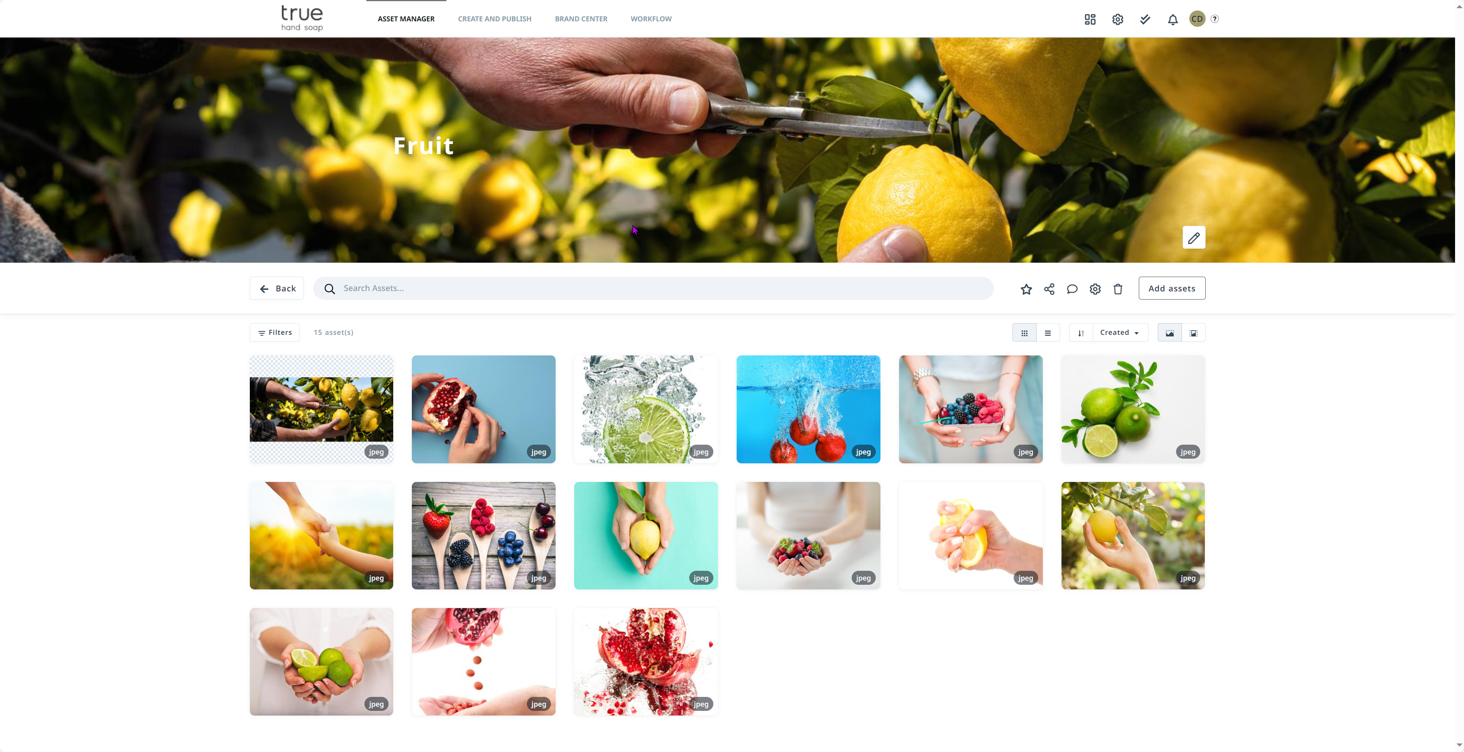
Collections
Provide users with a curated selection of assets in a Collection
Collections can be private just to you or publicly accessed by your users.
You can send a shared link to someone outside of the platform.
Read More: Collections | Lytho Guide

Slide 19
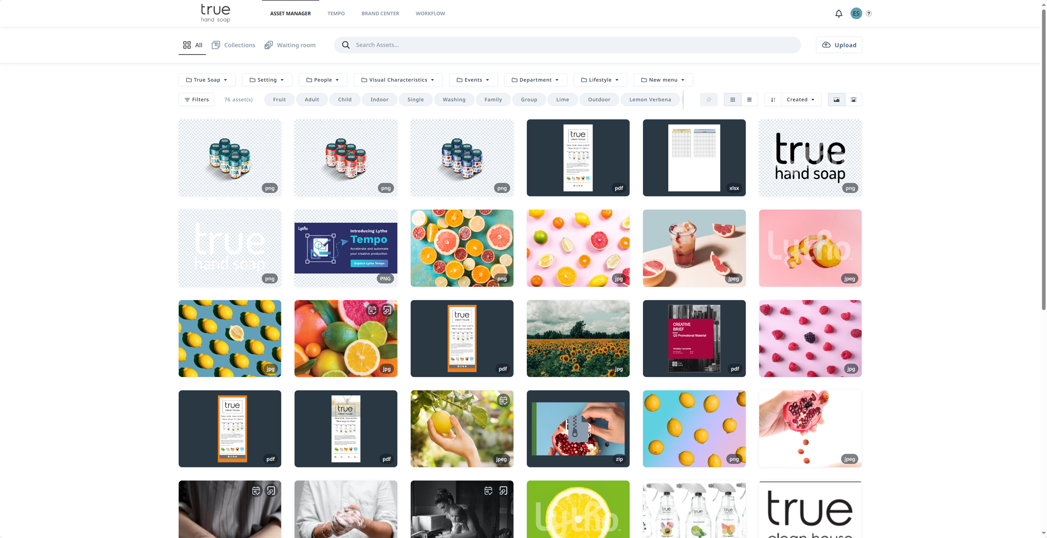
Uploading Assets
*Uploading assets will be available according to role settings
Click to Upload button to choose assets from your computer to add to the DAM
Waiting Room
Once an asset is uploaded, it won’t be available in the DAM until it has been approved. Admins or Roles with Approver rights will be notified and have the responsibility of approving assets in the DAM.
The asset will be available in the DAM once it's been approved.
Read More: Uploading Assets | Lytho Guide

Slide 20
(Optional)
Waiting Room
Take screen shots of your waiting room.
Talk to your team about who has approver rights in your organization.
What does the approval process look like?
Why do assets need to go through the Waiting Room before they will be available in the Asset Manager.

Slide 21
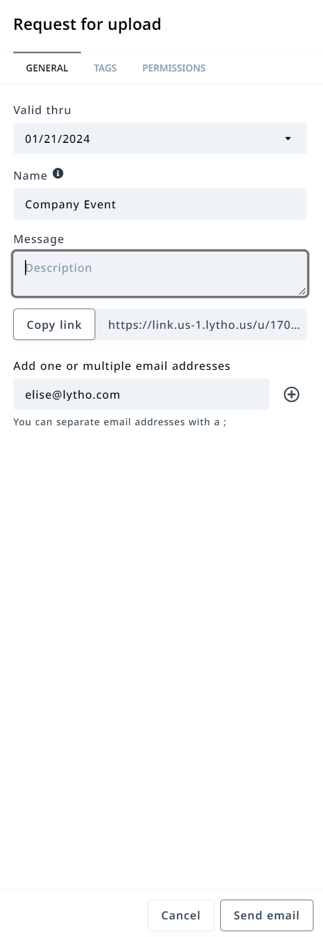
Request for Upload
The Request for upload feature in Lytho DAM is an easy way to ask for assets from users both inside and outside of your organization. This user does not need a Lytho account to send assets to your admin's waiting room for approval.
Click Request for Upload icon to start your request
The Request for upload model will appear. You will be able to set up the following before sending out the request:
Set a Valid thru date
Name of Request
Message to user about the request
Create a link to send out request
Or add email address to send an email request
Tags (available according to role settings)
Permissions (available according to role settings)
Read More: Request For Upload | Lytho Guide
*Request for Upload will be available according to role settings

Slide 22
Brand Center

Slide 23
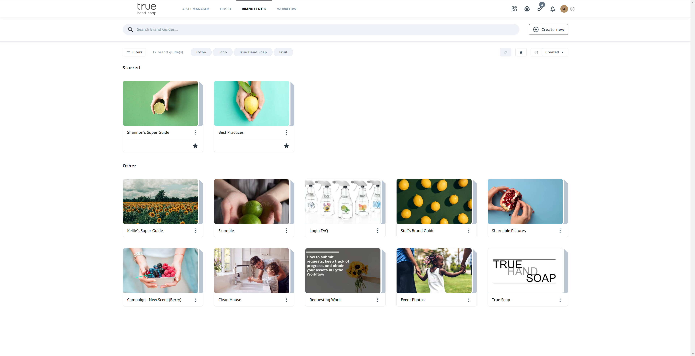
Brand Guides
Within Brand Center you will see an overview of all brand guides that are available for you.
Based on your user role and assigned rules you might not be able to see all guides.
Brand guides can be used to easily share information both inside and outside of your organization.
Most common brand guides include Organizational Brand/Style guides but can also include but not limited to Profile guides, Event guides, Process guides and Social Media guides.
Read More: Brand Center Overview | Lytho Guide

Slide 24
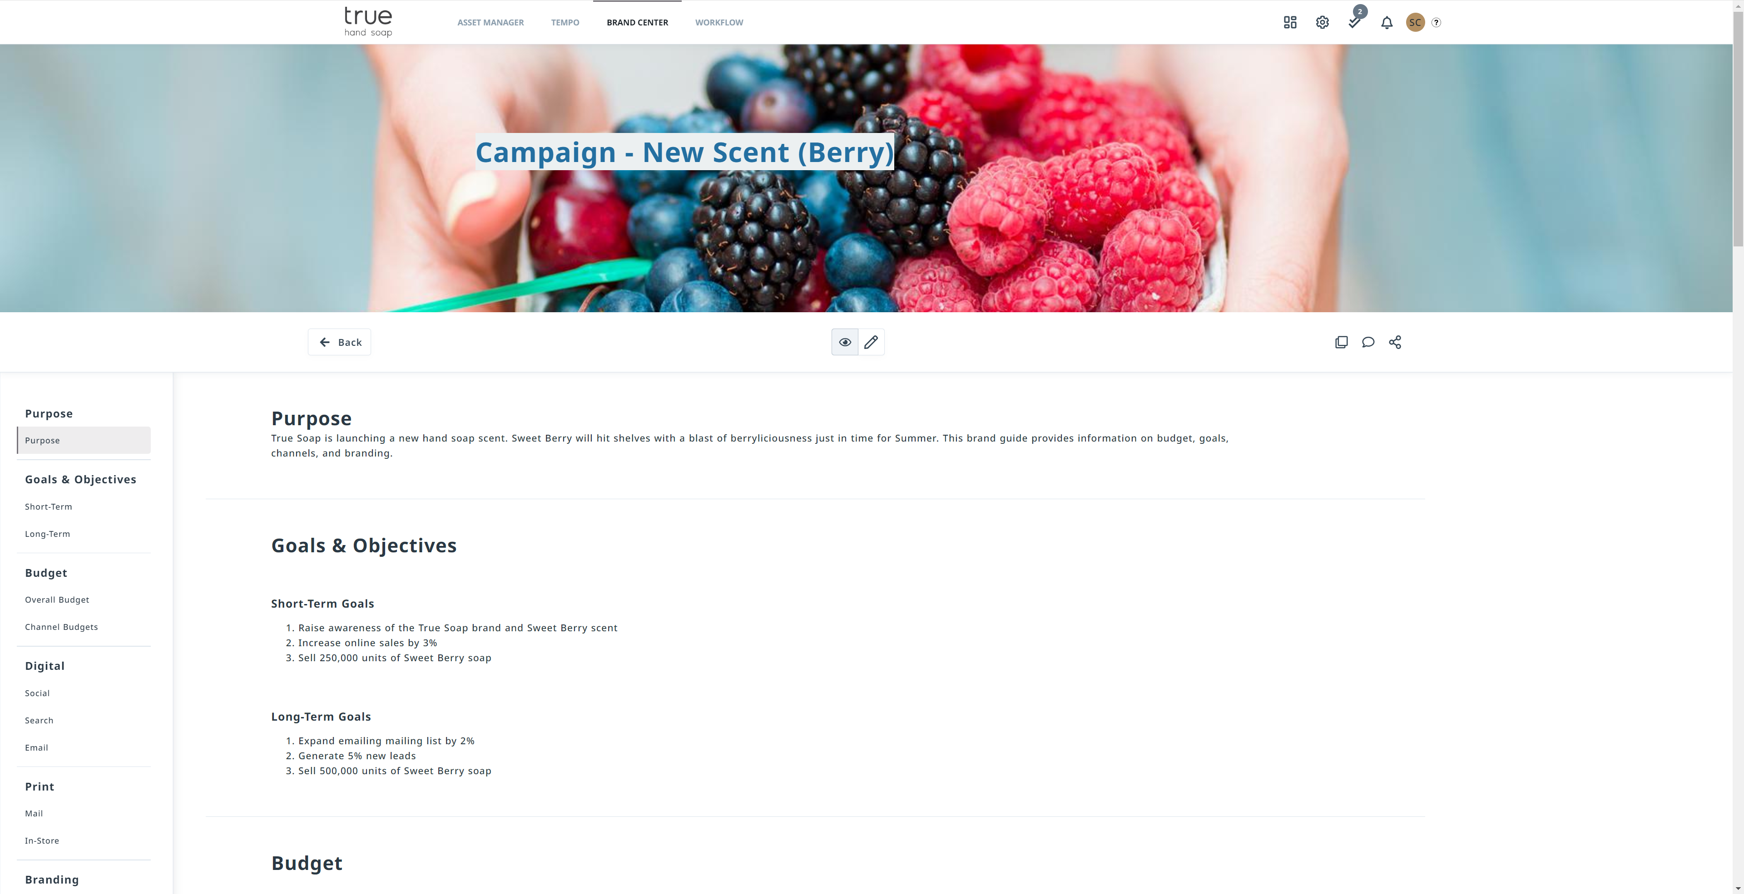
Accessing a Brand Guide
Clicking on the Brand Guide you would like to view will open the Brand Guide and allow access to the content.
Share icon will allow you to share the brand guide to others.
You'll find an interactive index on the left side you can use to navigate directly to a specific section.
*Brand Guides will be available according to role settings

Slide 25
Our Brand Guides
Add Screenshots of your Brand Guides and expectations around usage.
Who can see them?
How they should be shared.
Can a user download attachments?
Feel free to create multiple slides to show off your Brand Guides and talk through your expectations for each one.

Slide 26
Tempo

Slide 27
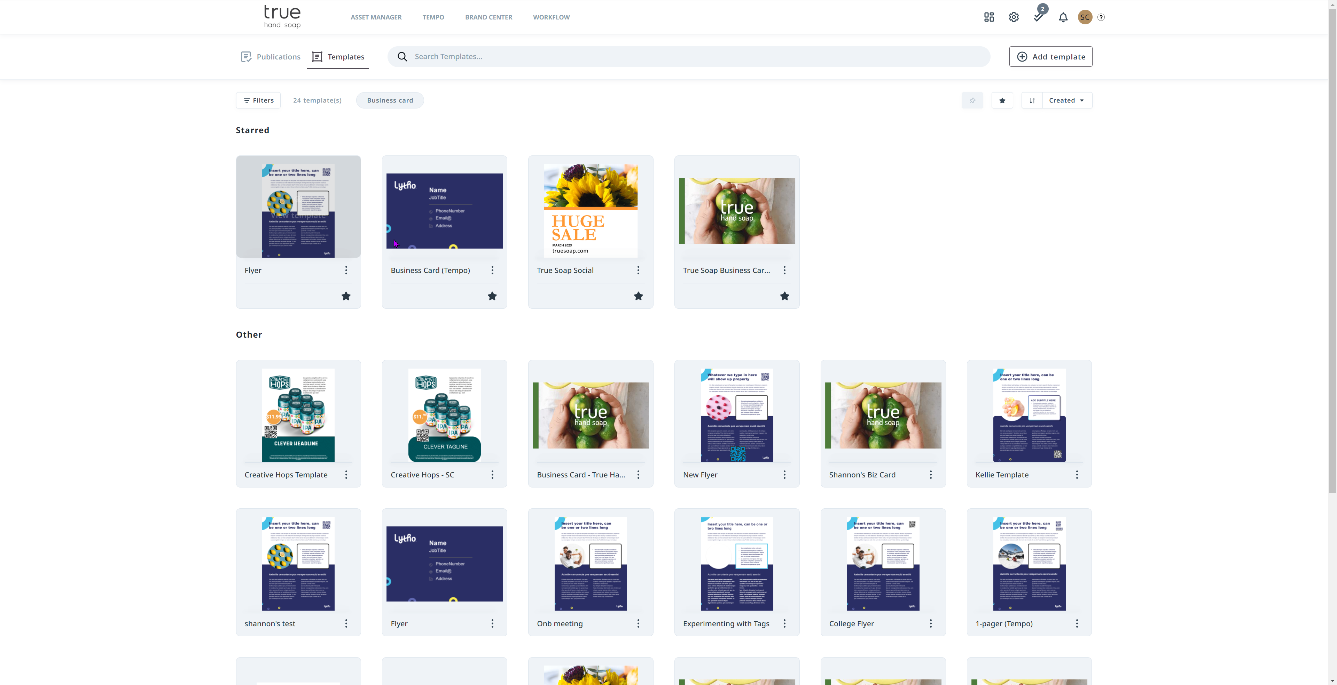
Tempo Smart Templates
Smart templates empower stakeholders to self-serve and create personalized materials that stay on-brand - reducing requests for smaller edits and variants.
Smart Templates in Tempo will be available according to your role & permissions
Once you create your publication, you can download and share it with others.
Read More: The Stakeholder Experience 🎥 | Lytho Guide

Slide 28
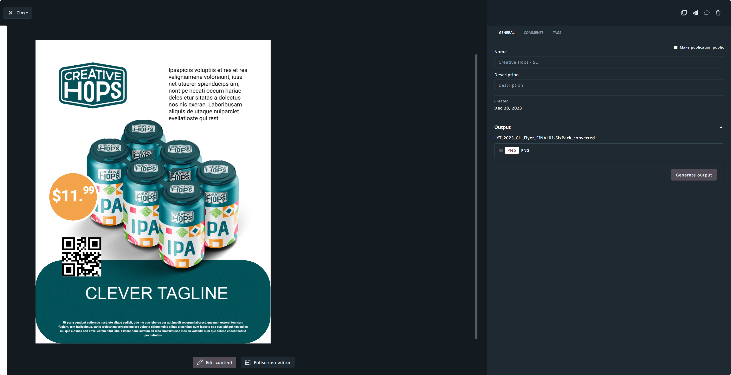
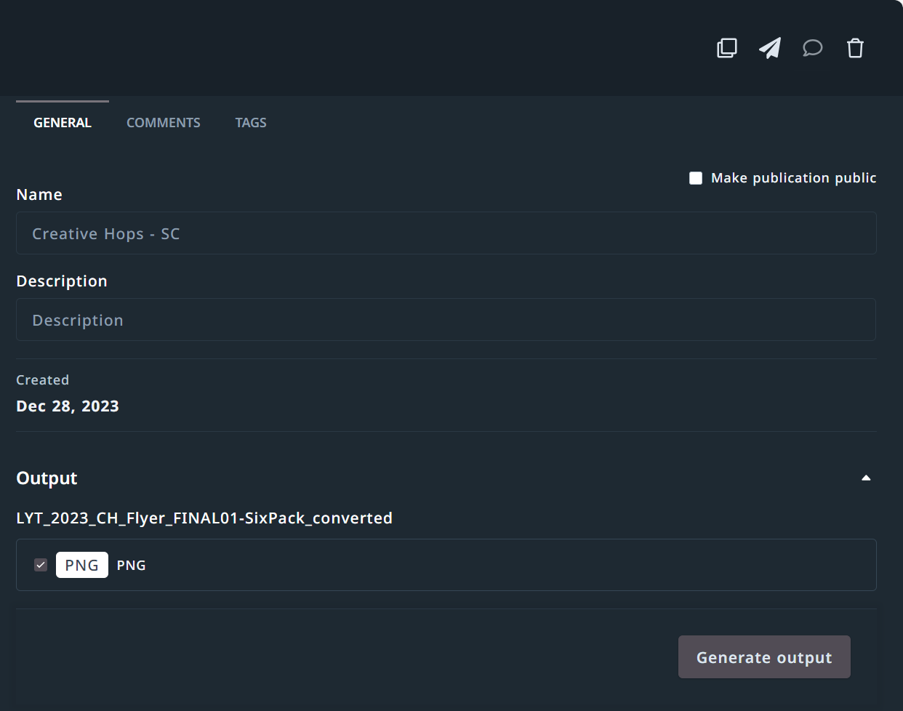
Creating a Publication
Duplicate, Send a Copy, Message or Delete publication
Make publication public – publications you create are by default private to only you. If you make them public this will allow you to message other users about this publication and others will be able to see the publication.
Share & Download - If you see these two icons a render has been created, and you DO NOT need to generate another output.
Generate Output – *creates a render
1
2
Each time a publication is created with the "Generate Output" button, it counts as a render. Our subscription includes X number of renders per year.
You can preview your publication without generating a render. If you download the publication and upload it to the DAM, it can be used and redownloaded without counting as additional renders.
3
Include the number of renders your organization has available per your contract.
4
Read More: Renders | Lytho Guide

Slide 29
Demo Time
Use one of your Smart Templates to show your Team Members how to create a publication

Slide 30
Dual Module
Workflow + DAM

Slide 31
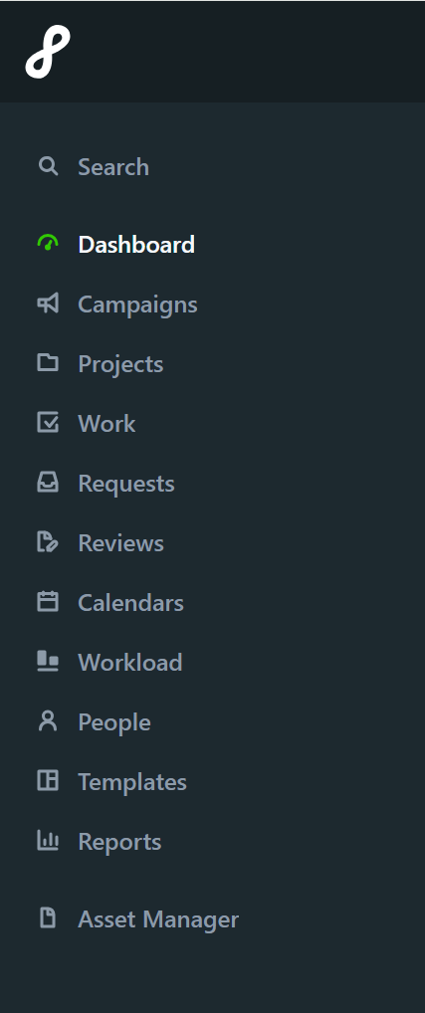
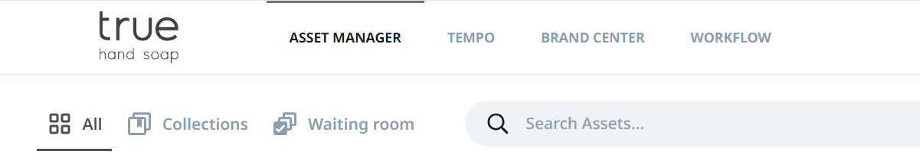
Unified Creative Operations Platform
With both Workflow + DAM you can easily streamline your Creative processes.
Unified login page
Seamless DAM integration for your Workflow
Push Workflow deliverables into DAM
Simple navigation between platforms
One source of truth for all things creative

Slide 32
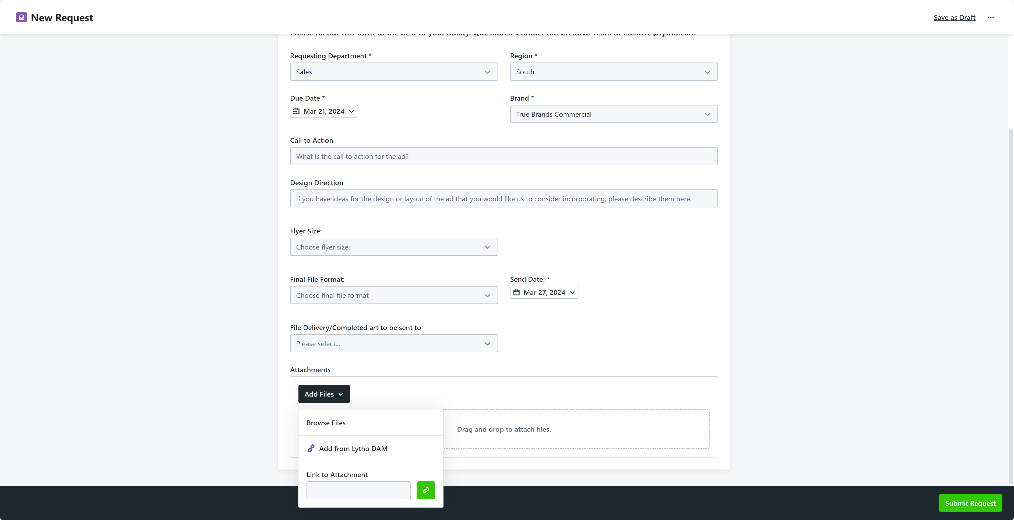
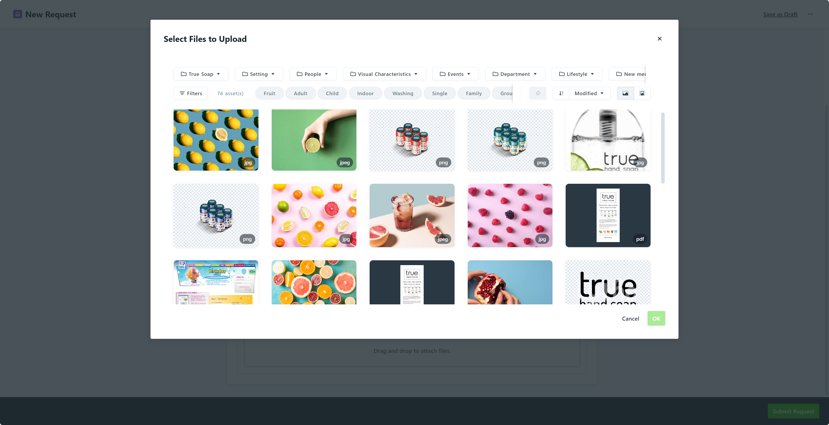
Workflow – Requests
  When a Requester fills out a request form, they can upload attachments in the Attachment field directly from your DAM.
  They will be able to select the files they would like to attach to their request
  *Assets available to the Requester will be based on their permissions
2
1

Slide 33
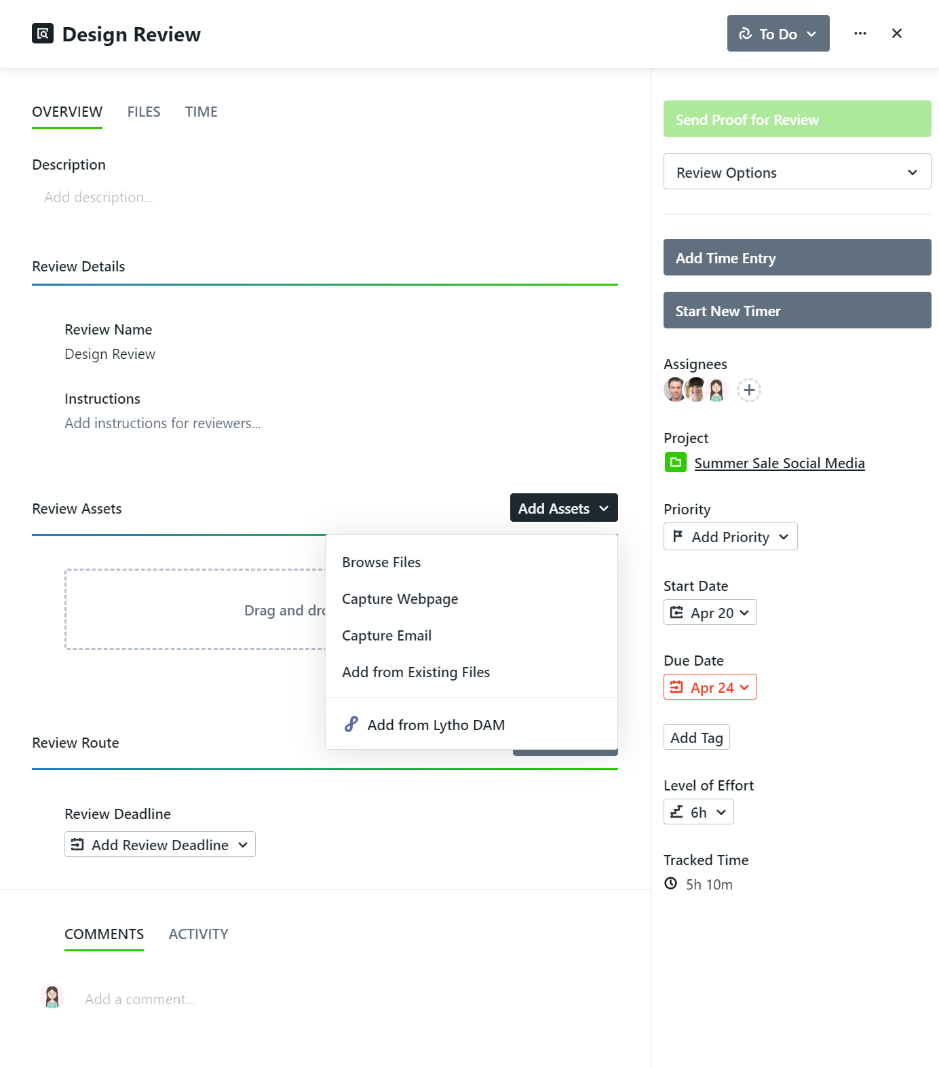
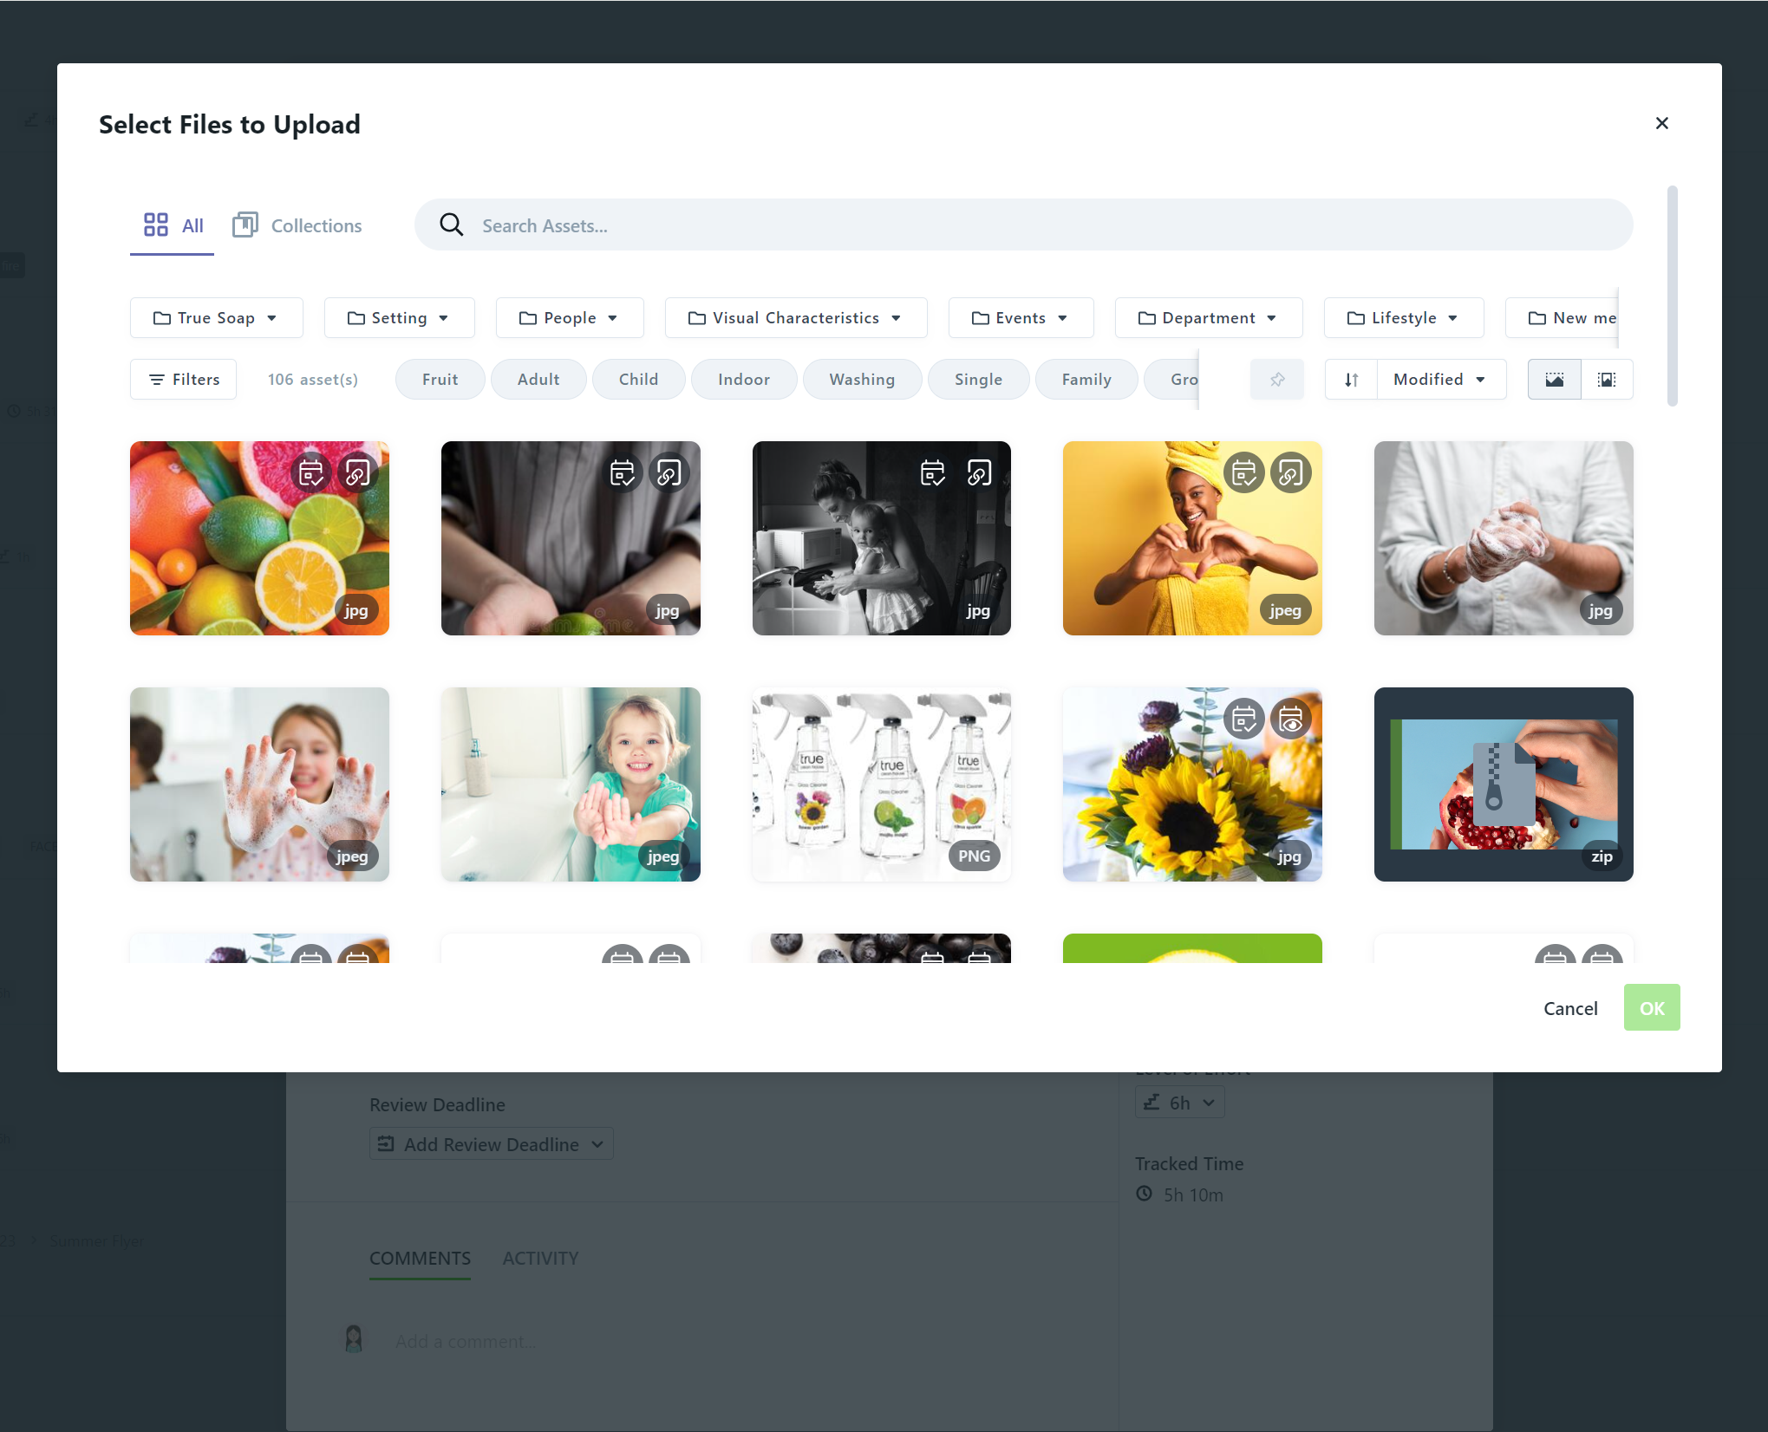
Workflow – Proofs
  When sending out a proof for review you can add directly from your DAM.
  You will be able to select the files you would like to send out as a proof.
  *Assets available to the Team Member will be based on their permissions
2
1

Slide 34
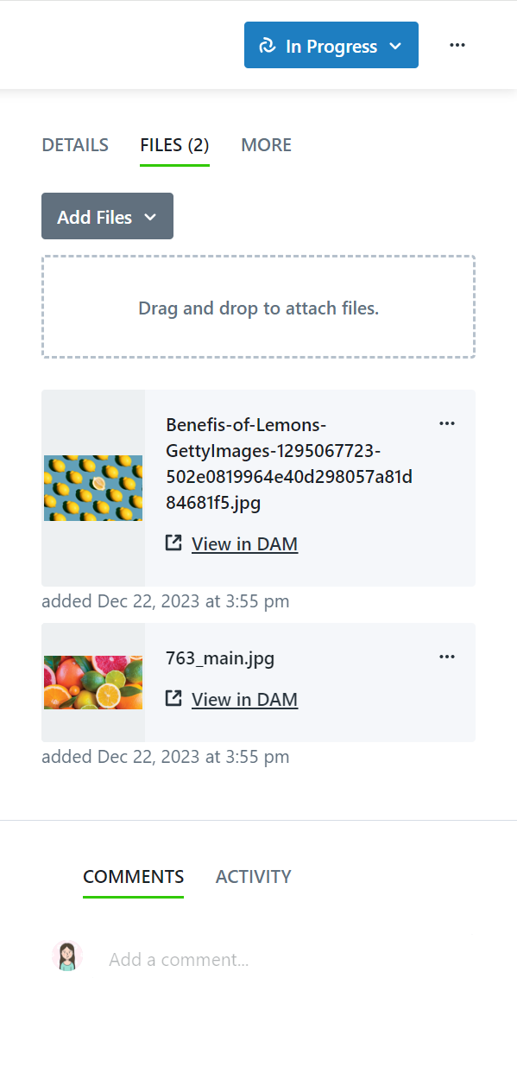
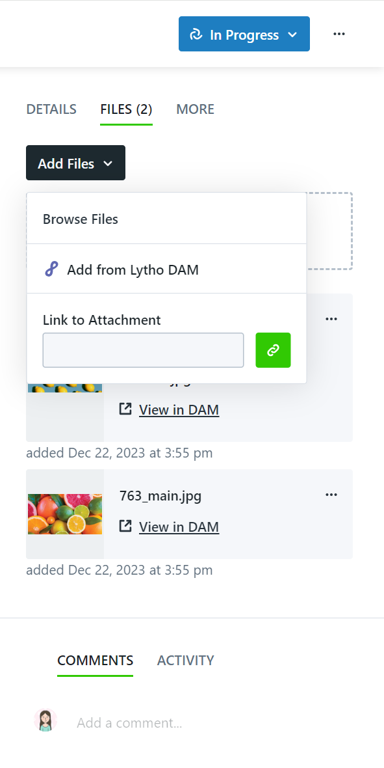
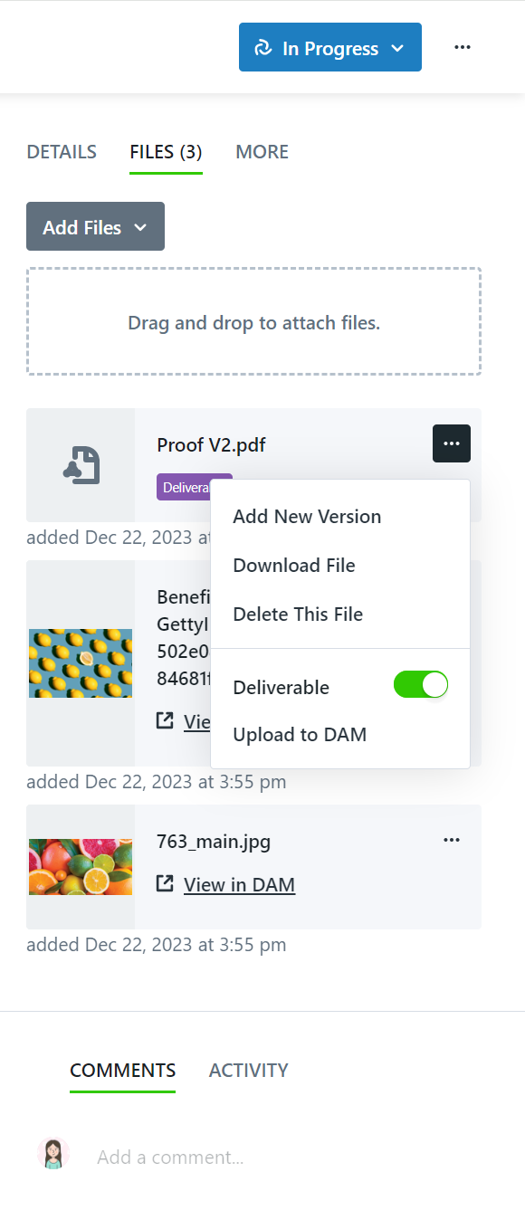
Workflow – Projects
  View project files in your DAM – allows you to see asset information
  Add project files from your DAM – easily pull assets into a project
  Upload Deliverable files to your DAM – consistency on where assets are stored
1
2
3

Slide 35
Additional Features

Slide 36
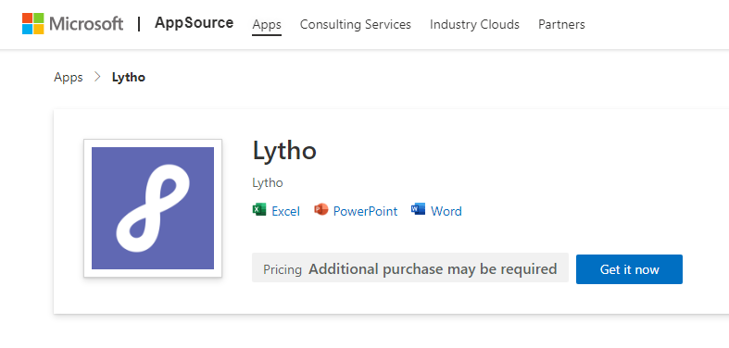
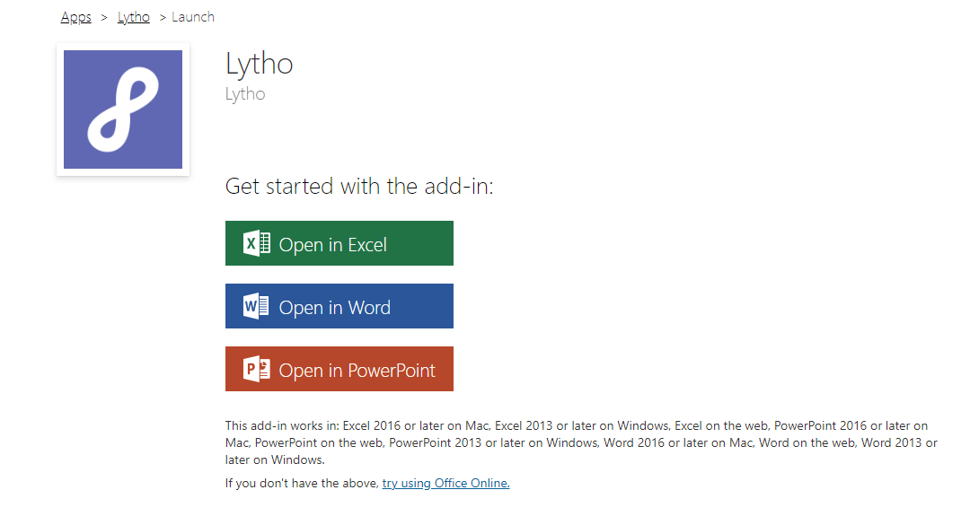
Microsoft Office Add-in for Lytho DAM
Easily select images to use in your Word, PowerPoint, and Excel documents.
The Lytho Microsoft Office add-in enables you to search and filter through assets within your Lytho DAM environment without leaving your document.
Once you're done editing, you can upload your document directly into the Waiting Room.
Read More: Microsoft Office Add-in for Lytho DAM | Lytho Guide

Slide 37
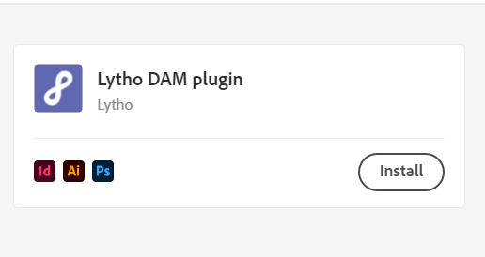
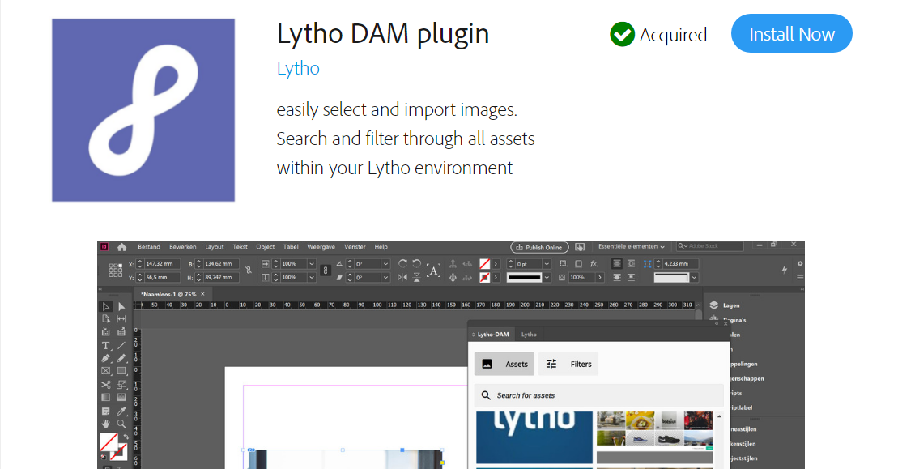
Adobe Creative Cloud Plugin for Lytho DAM
Easily select images to use in your InDesign, Photoshop, and Illustrator documents.
The Lytho DAM plugin for Adobe CC enables you to search and filter through all assets within your Lytho DAM environment without leaving your document.
Once you're done editing, you can upload your document directly into the Waiting Room.
Read More: Adobe Creative Cloud Plugin for Lytho DAM | Lytho Guide

Slide 38
Action Items
Customize this list for the actions you want your team to complete after training!
Accept invitation
Search for items in your DAM using the Search Bar and filter options
Download the Microsoft Office add-in
Download the Creative Cloud plugin
Contact [your name] with any questions!

Slide 39
Additional Slides
Duplicate this slide to create additional slides for Team Training.
You can add more information about:
Download & Cropper Presets
Variants, Versions & Related Assets
Request for Download
Creating Brand Guides
Process for requesting new templates
Process for storing new deliverables in the Asset Manager

