Slide 1
Stakeholder Training

Slide 2
Agenda
Introduction to Lytho Workflow
Platform Overview & Navigation
Requests
Reviews
Final Files
Action Items

Slide 3
Welcome to Lytho Workflow!
Lytho Workflow is the most versatile platform purposely designed to empower teams to achieve better content outcomes for their brand. From request intake to project management to proofing, Lytho Workflow will help us align, manage, and assess our creative and marketing content.
List of all the reasons that your company chose this platform including:
Problems being solved
Outcomes you’re using Lytho Workflow to help you achieve
Expectations for trainees following the training (examples: creating your account, etc.)
Provide the dates of your roll-out schedule – when you will train Stakeholders and go live!

Slide 4
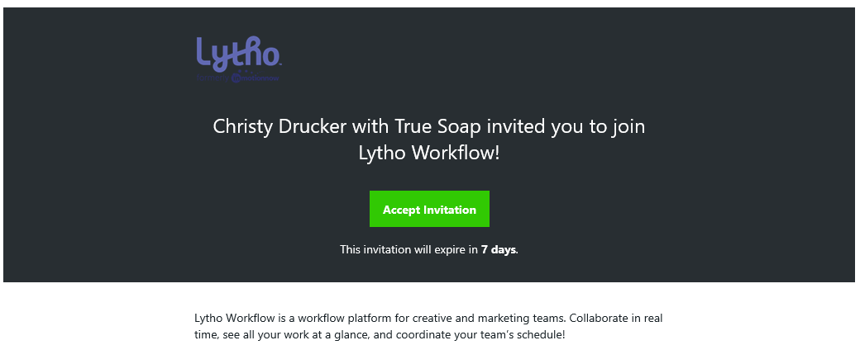
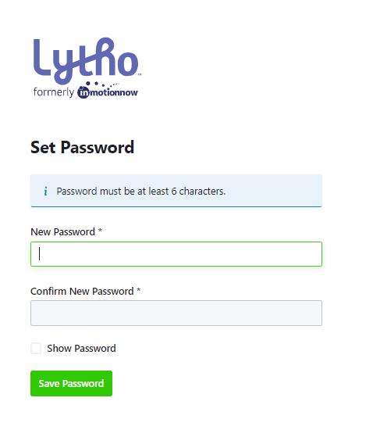
Create Your Account
1
You will receive an email from welcome@inmotionnow.com. Accept it!
Invites expire in seven days. If your invite expires, contact your name/main admin.
Accept invitation immediately
Create your account by setting a password
Password requirements include:
Bookmark our unique inMotion ignite URL: teamname.ignite.inmotionnow.com
If you have trouble logging in, check out these Login FAQs
2

Slide 5
Platform Overview & Navigation

Slide 6
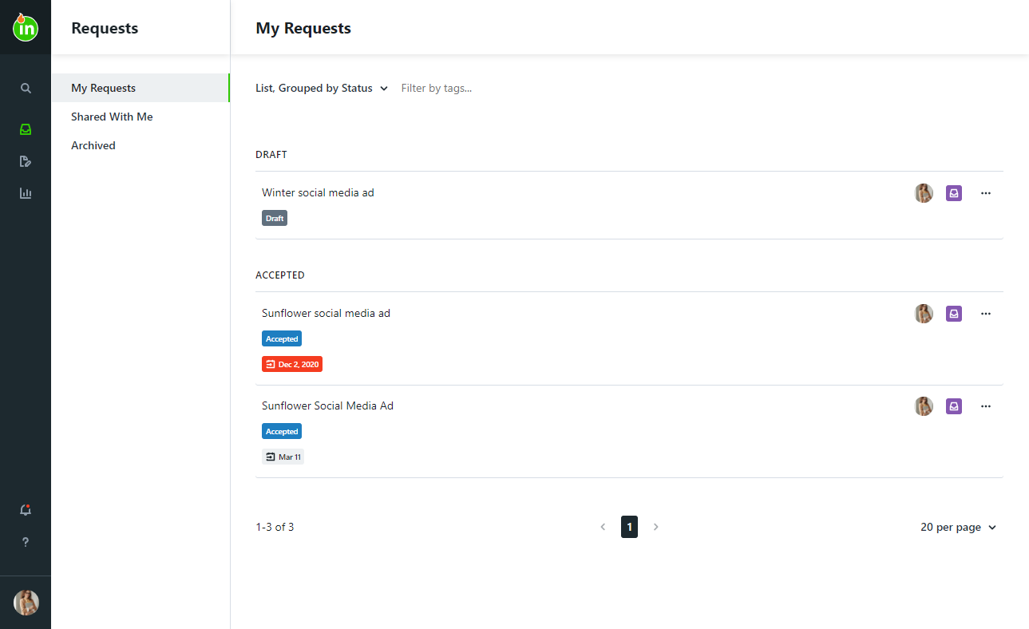
Navigating Through ignite
You will see “My Requests” when you first log in.
Global Search
Create & Monitor Requests
Complete Reviews
See Shared Reports
Notifications
Personal Settings

Slide 7
Requests

Slide 8
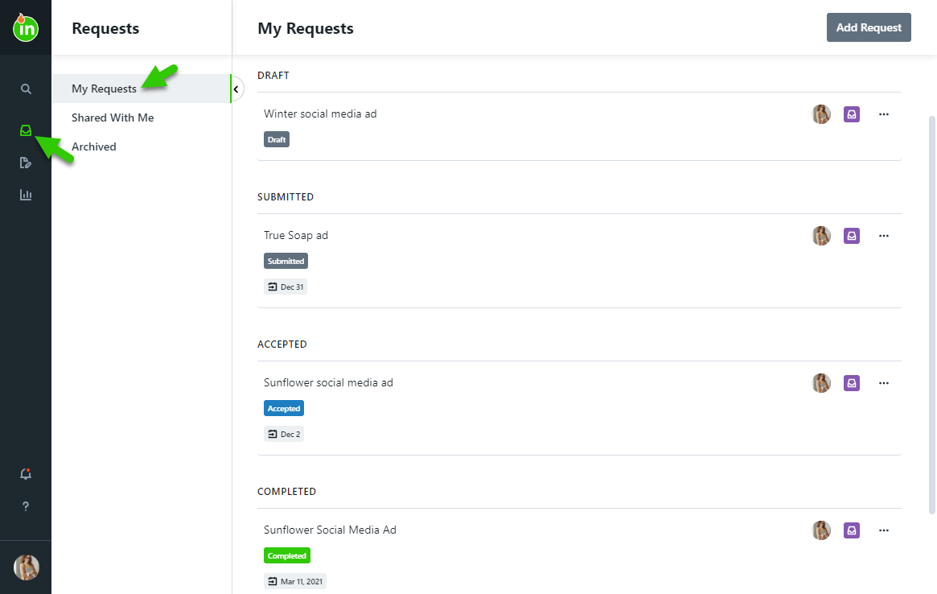
Requests
Create a New Request
Requests progress through the following statuses:
Draft: Still in progress; not yet submitted by the requester
Submitted: Acceptors are notified of the new request for review
Accepted: Acceptors have approved the request and created work to fulfill the request
Completed: Work is complete & the requester is notified
Archived: Work has been archived for future reference
Read More: https://support.lytho.com/support/solutions/folders/151000551330

Slide 9
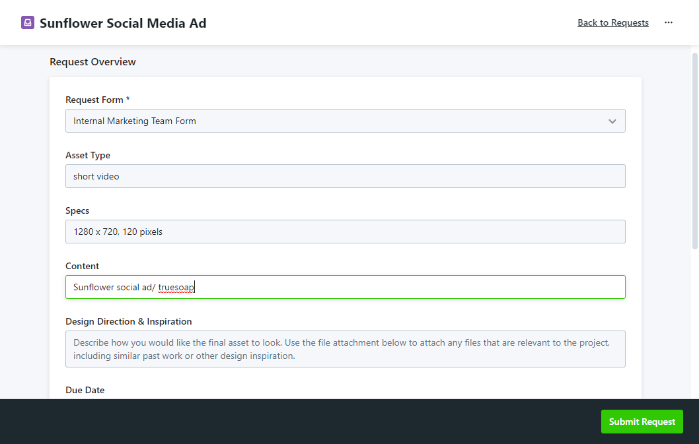
Creating a Request
Navigate to the Requests tab
Select Add Request
Name your request
Select the best form for your request needs
Fill out the form in detail – inputs are saved automatically!
Submit the request

Slide 10
Requests
Add Screenshots of your request forms & highlight fields that are important to your process.
Feel free to create multiple slides to show off your Request Forms and talk through your different expectations for each form ☺

Slide 11
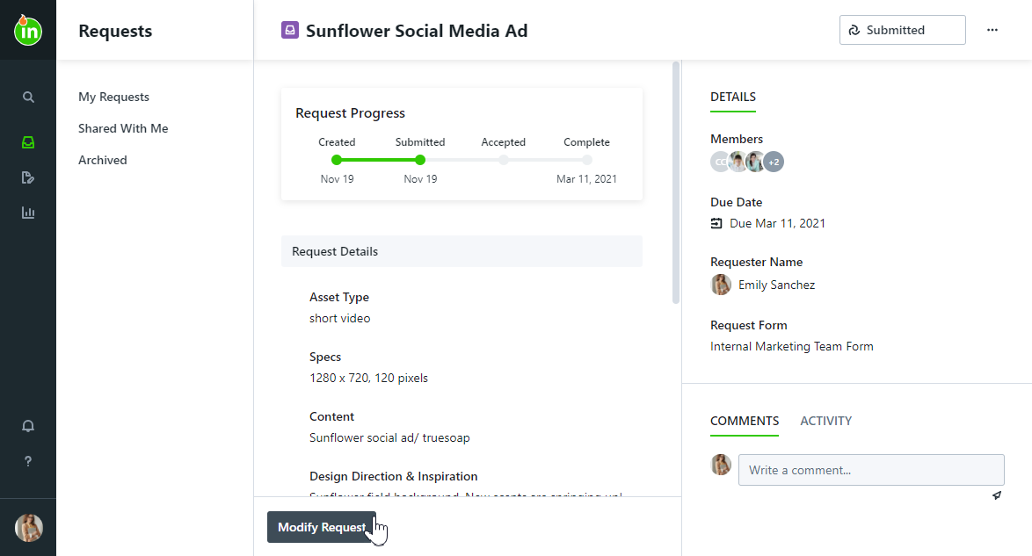
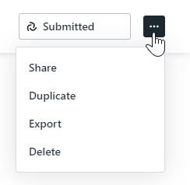
Updating & Sharing the Request
Before the request is accepted, you can modify it and/or communicate with acceptors. Once accepted it can no longer be modified.
Share your requests so that your submission and assets can be shared with others.
Duplicate requests to reduce repetitive work.
Export the request as needed to view outside of ignite in a PDF format.

Slide 12
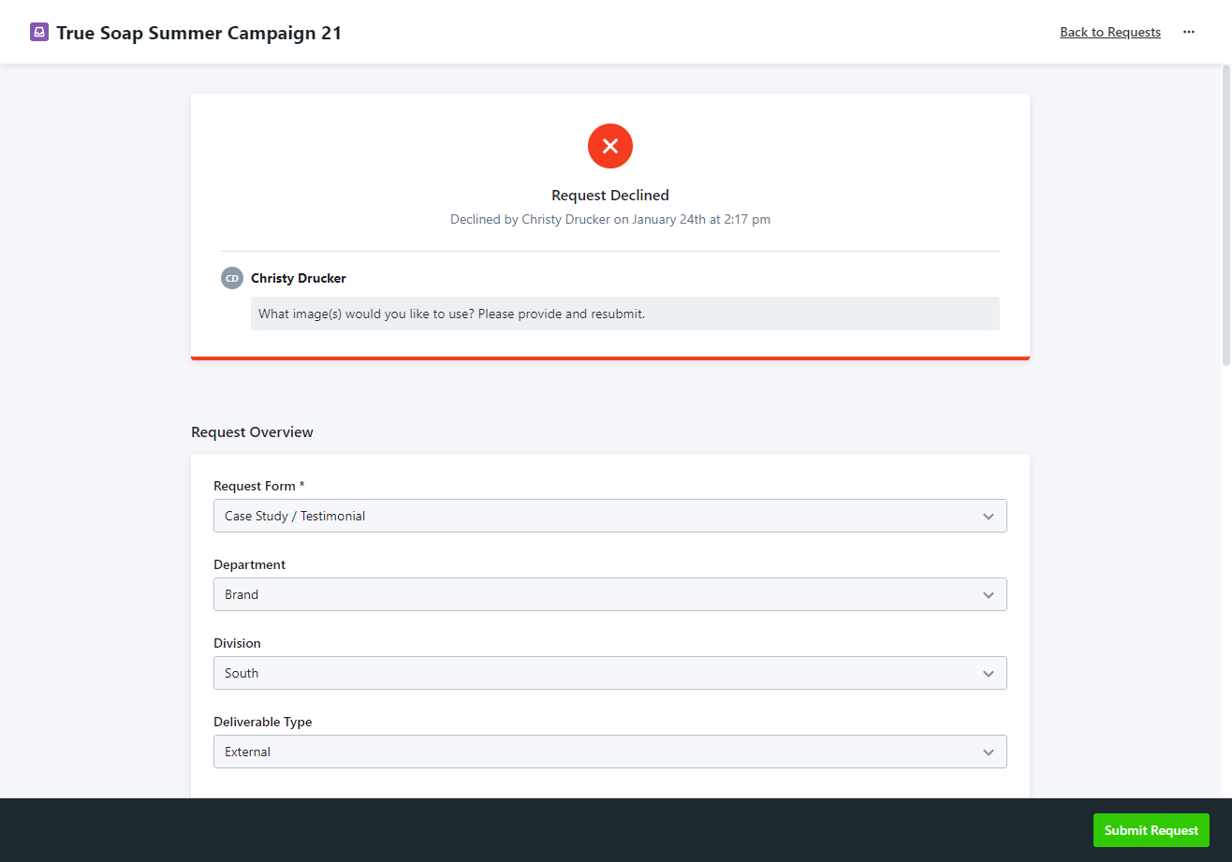
Resubmitting a Declined Request
If your request is declined, you will receive a notification that includes a message explaining why the request was declined
Your request will return to Draft status
Provide the needed information and then you can resubmit

Slide 13
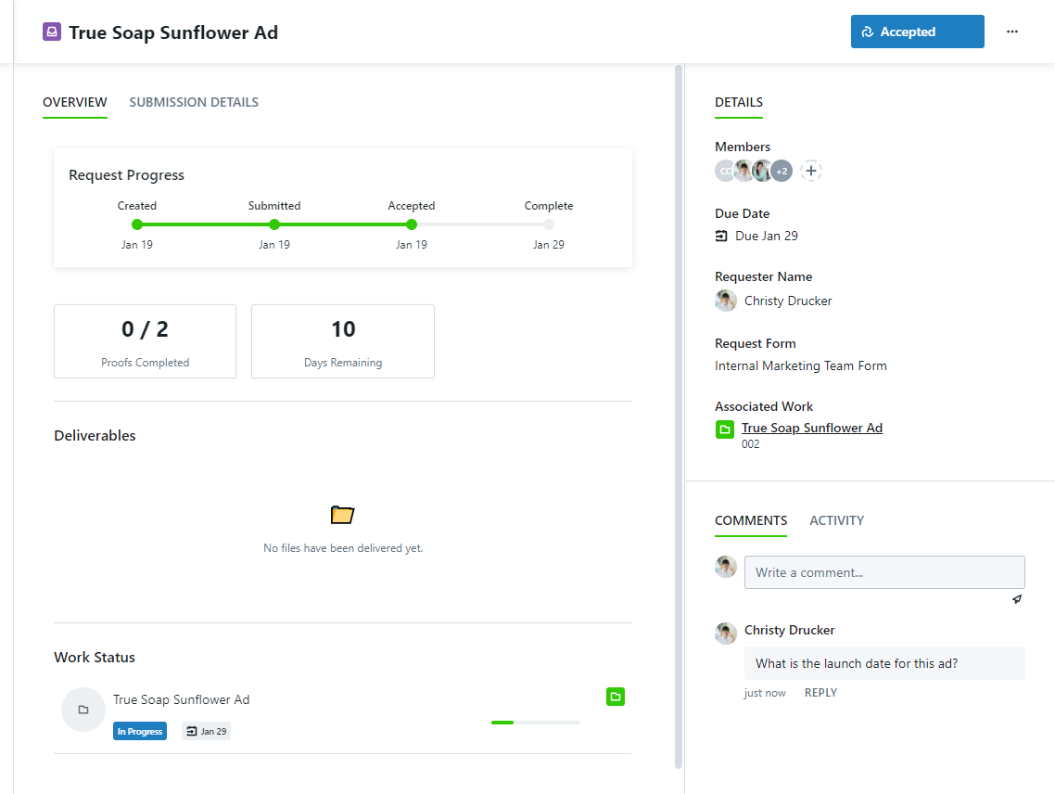
Monitoring Request Progress
You will be notified when:
The request is accepted
The request is completed
Any changes are made to the request due date
You are @mentioned or replied to in a comment
The original request can be viewed in the Submission Details tab
As work begins, you will see:
Progress of associated work- this indicator will appear in red if work is overdue
Proofs completed
The number of business days remaining
All files shared as Deliverables

Slide 14
Reviews

Slide 15
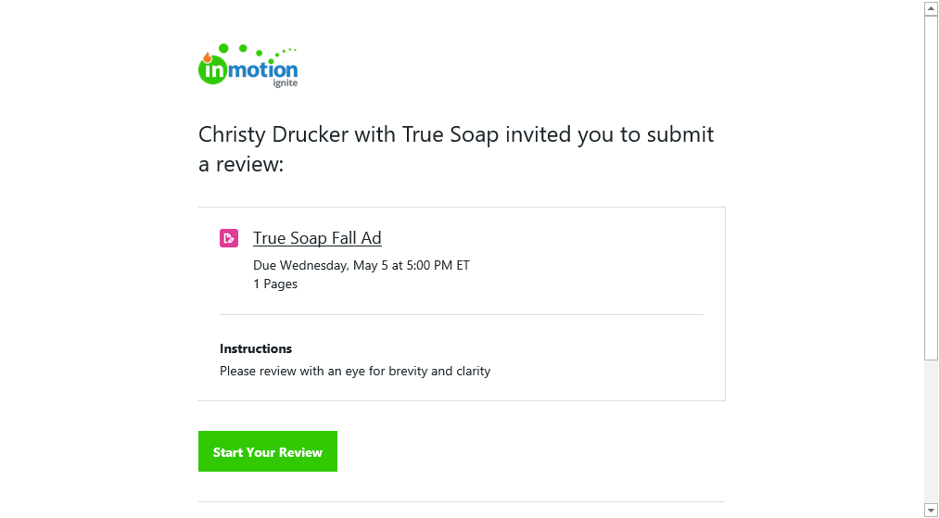
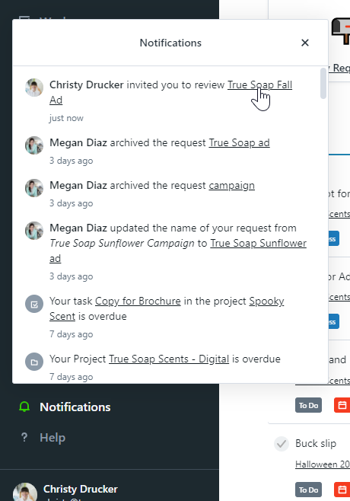
Receiving Your Invite to Review a Proof
You will receive an email from noreply@lytho.com including the:
Review Name
Review Deadline
Review Instructions
Number of Pages
Associated Project Name & Due Date
Click “Start Your Review” to access the review

Slide 16
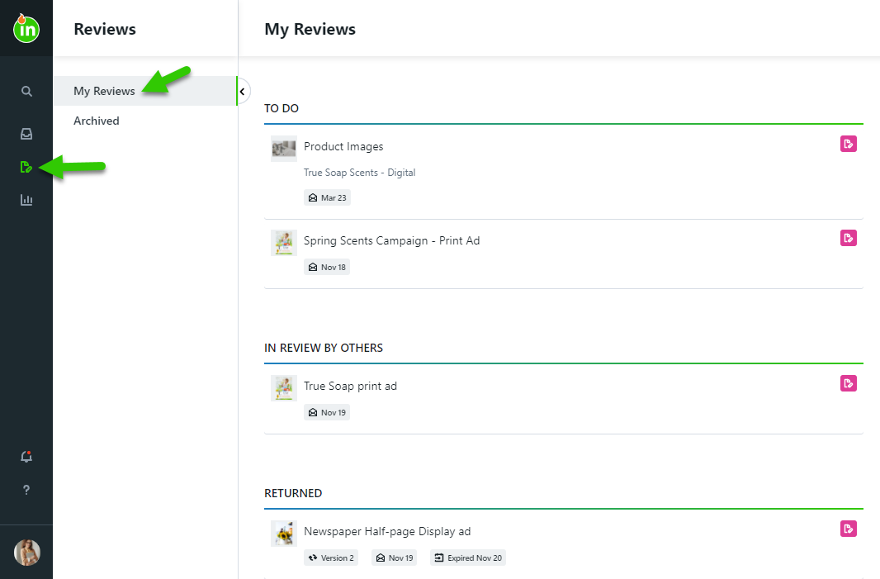
Reviewing a Proof
Find reviews awaiting your approval on your Dashboard or within the My Reviews tab. Reviews will progress through the following statuses:
To Do: Your approval needs to be provided
In Review By Others: You have completed your review, but the proof is still pending the review of others
Returned: Reviews that have ended
Archived: Reviews that have been archived for future reference

Slide 17
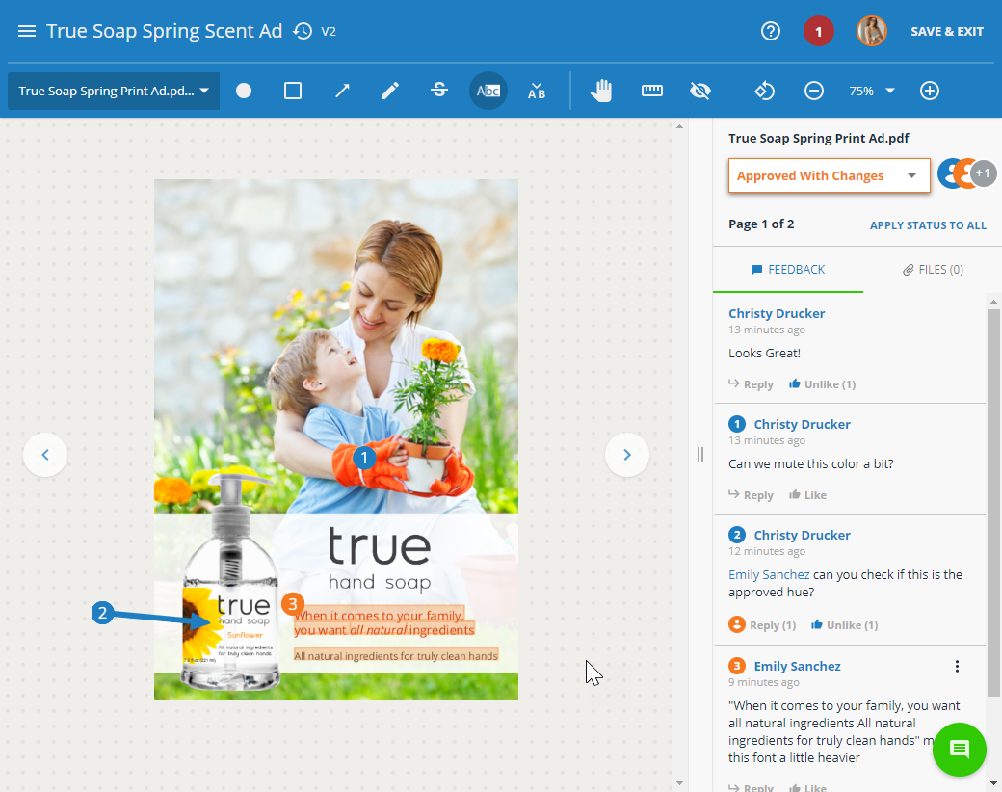
Provide Feedback
Provide feedback by marking up the assets using the intuitive annotation tools in the toolbar.
Each annotation will automatically be numbered and associated with a comment
Use the page navigation menu or the arrows next to the asset to navigate through review pages
@mention other reviewers, like other comments, and attach files to comments
You can also share the review with others not invited via @mentioning or the share menu
Read More: https://support.lytho.com/support/solutions/articles/151000189878-quick-start-guide-submitting-a-review

Slide 18
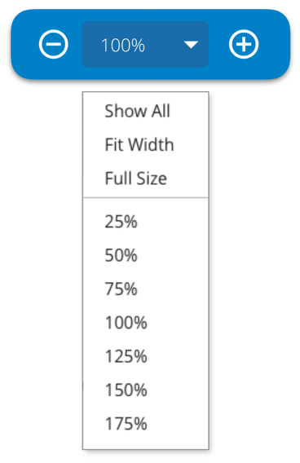
Reviewing Tips & Tricks
Use the Zoom Tool instead of your browser zoom.
You have options to ‘Show All,’ ‘Fit Width,’ and see ‘Full Size’
The max level may vary based on the asset size and your choice of browser
Assets default to “Show All,” which allows the reviewer to see the full length and width of the asset
Your browser’s built-in spell checker will automatically underline any misspelled words in your comments
Text markup tools are only available if text can be identified in the asset. This includes common file formats like .pdf or .doc
If the asset being reviewed includes text, use Ctrl+F to search for a word or phrase

Slide 19
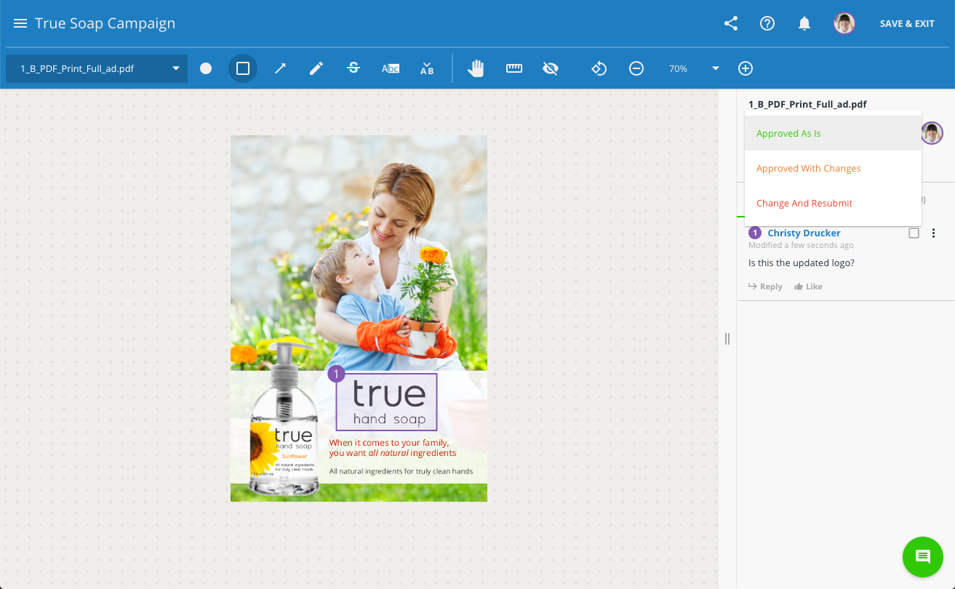
Select an Approval Status & Submit
You must select an approval status for each page, or you can apply one approval status to all pages (Update definitions below per your process)
Approved As Is: If you require no changes
Approved With Changes: If at least one change is required but you do not need to see another version for it is finalized
Change & Resubmit: If you need to see another version before the asset is finalized
When approved statuses have been selected for all pages, you must submit your review!
Read More: https://support.lytho.com/support/solutions/articles/151000189878-quick-start-guide-submitting-a-review

Slide 20
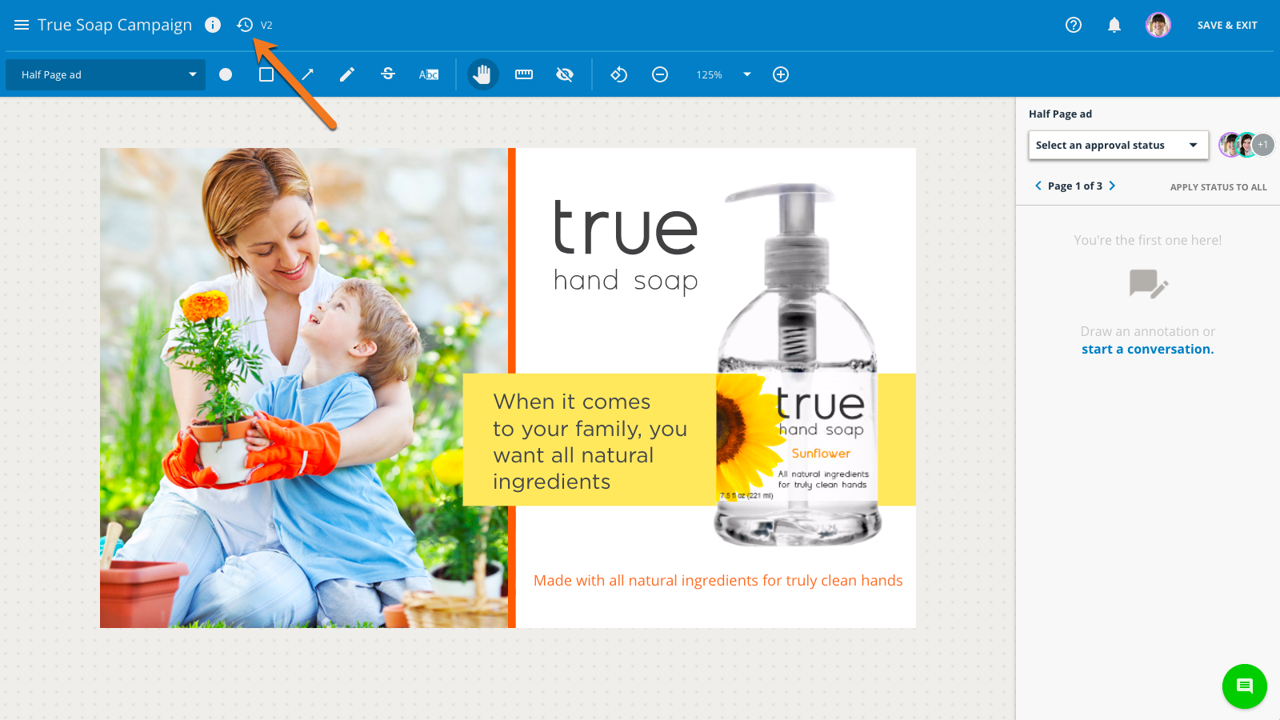
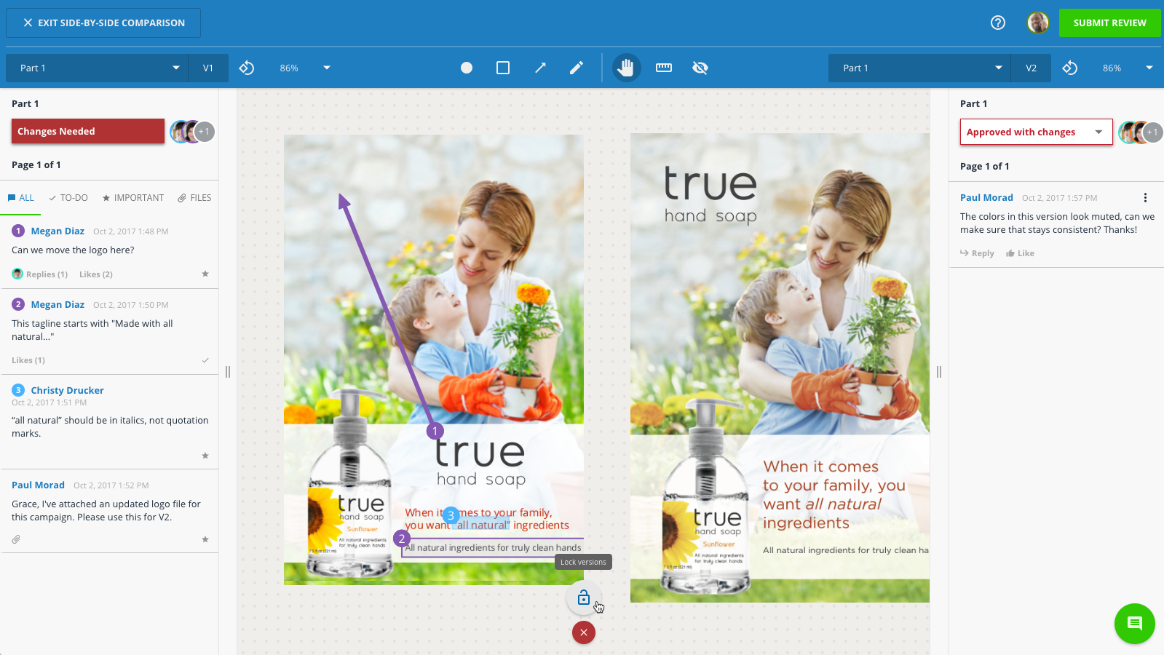
Review Past Versions Side-by-Side
If the proof is versioned, you can also access previous versions by selecting the versioning icon located to the right of the review name.
The proof’s version history will open to the left.
Hover over the version you’d like to reference to open it in either side-by-side comparison or a new tab of your browser
When in side-by-side mode, click the lock icon near the bottom center of the screen to pan, zoom, rotate, and navigate through both versions in tandem
You will not be able to comment on past versions – only the active version
Read More: https://support.lytho.com/support/solutions/articles/151000189882-proof-versioning

Slide 21
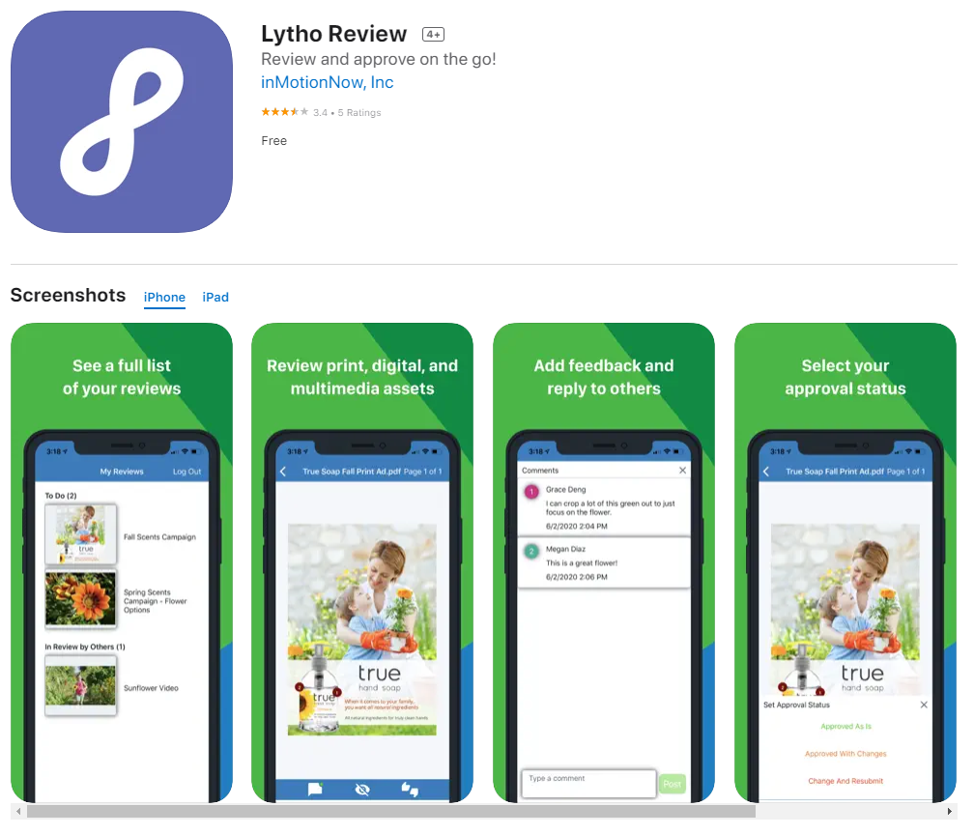
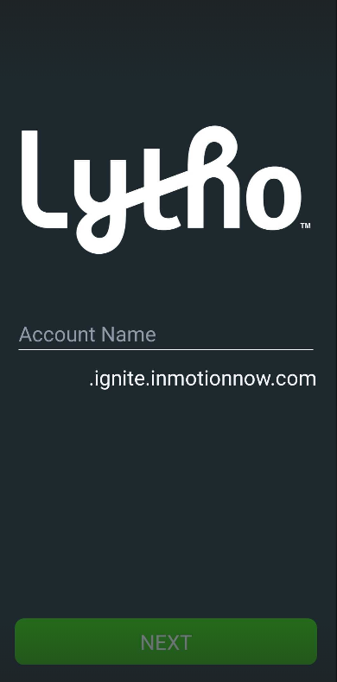
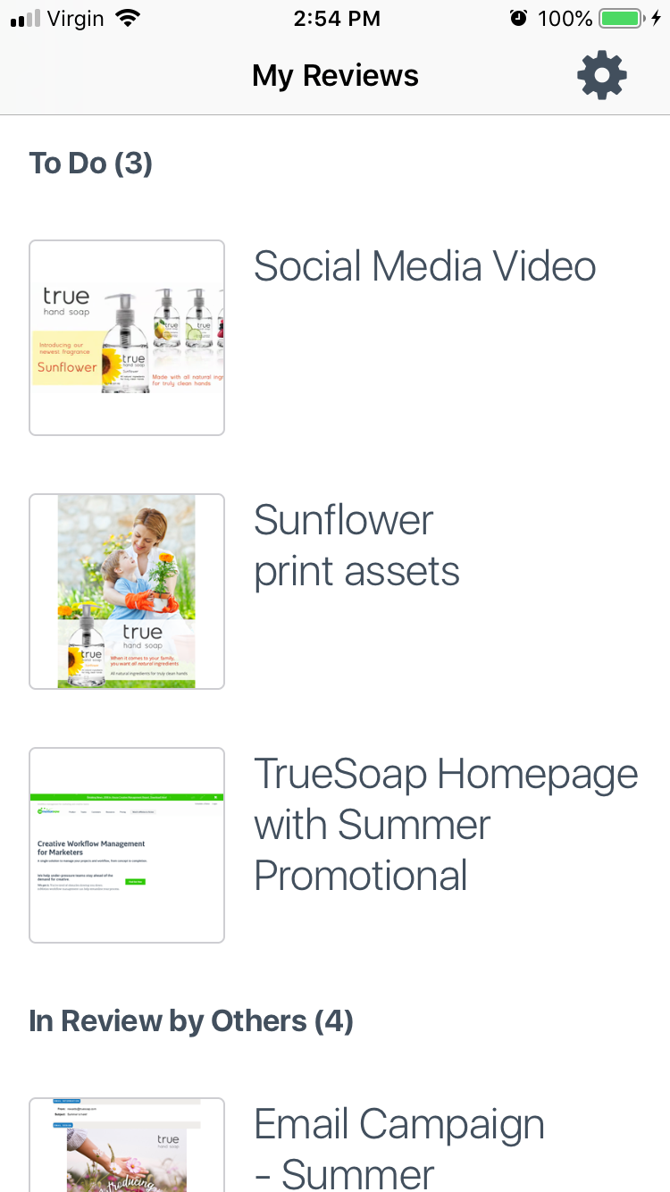
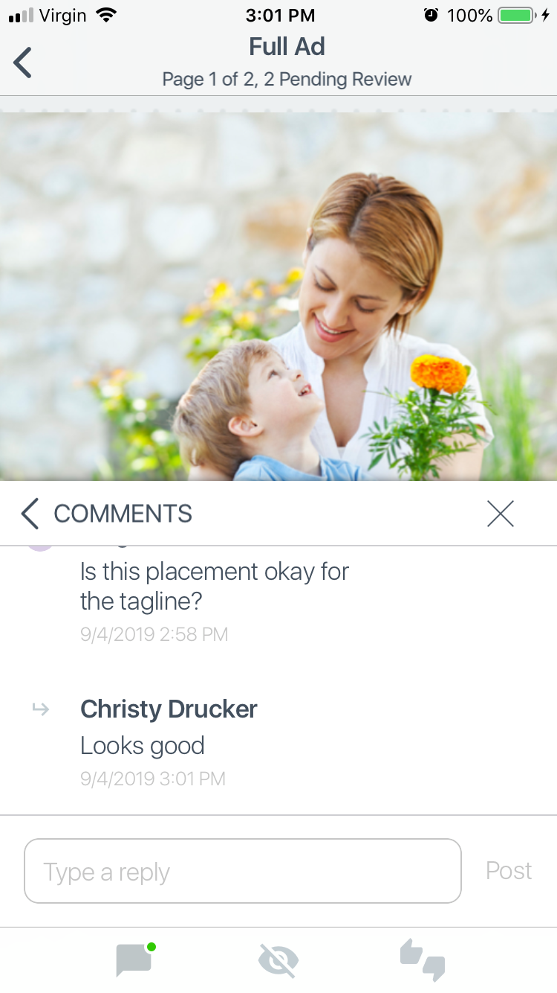
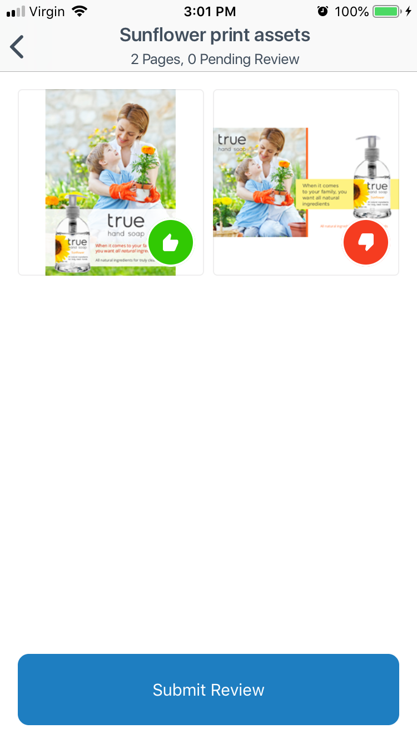
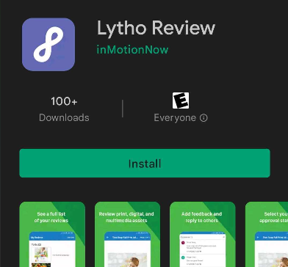
Lytho Workflow Review App for iOS and Android
Enter Subdomain
View Reviews
Provide Feedback
Submit Your Review!
Download the App for iOS & Android
Read More: https://support.lytho.com/support/solutions/articles/151000189885-lytho-review-app-for-ios-and-android

Slide 22
Final Files

Slide 23
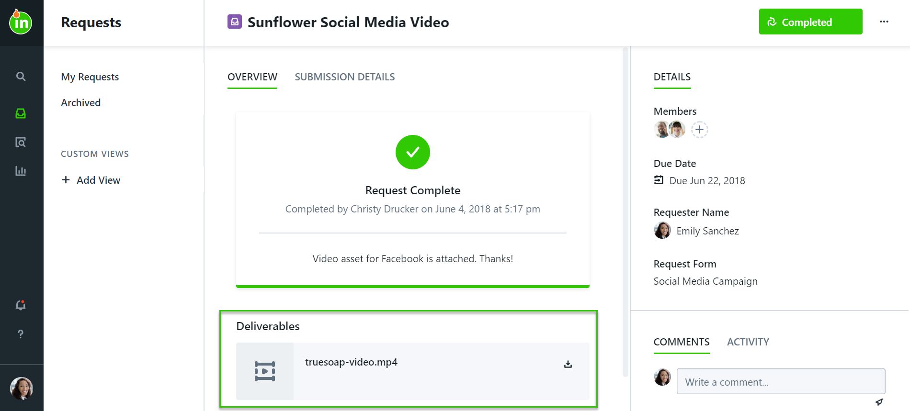
Final Files & Request Completion
You will be notified when the request is complete
Access & download all provided final files in the Deliverables section of the request
These files will remain in Lytho Workflow so you will always have access to them
Archived requests will remain available in the Archived section of your Requests tab
If you have trouble finding a completed request, don’t forget to use Global Search!

Slide 24
Action Items
Customize this list for the actions you want your team to complete after training!
Accept Invitation & Create Your Account
Download the iOS/Android app
Contact [your name] with any questions!

